Slide 1
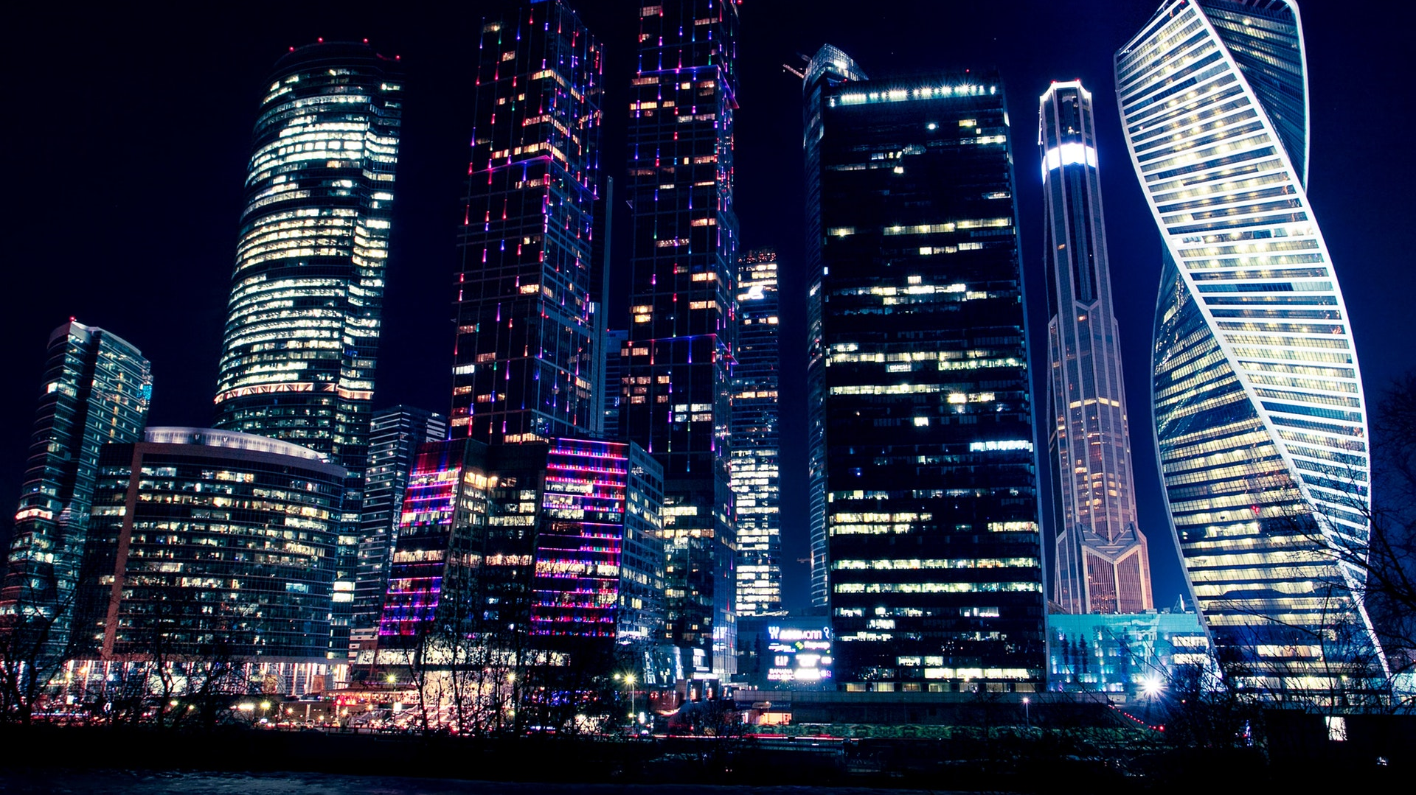
wanderLUST
“Life is about the adventures you take and the memories you make. So travel often and live life with open eyes and an open heart.”
― Katie Grissom

Slide 2
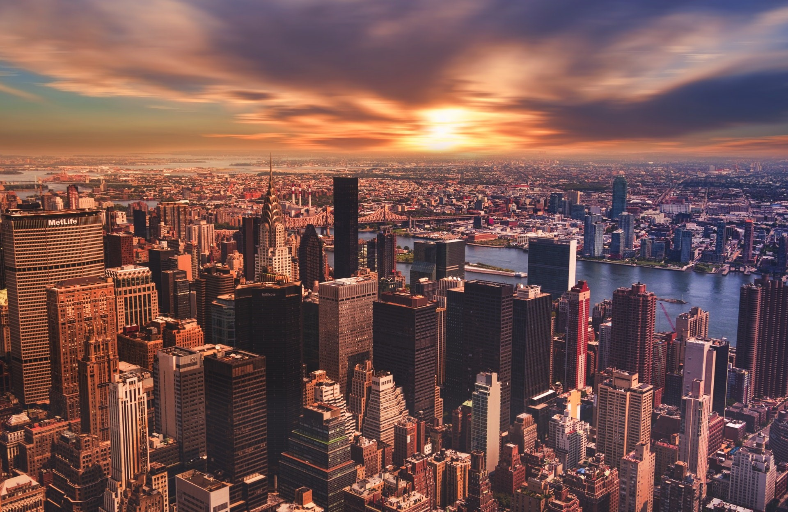
wanderLUST
2
0
2
0
ANDROID APPLICATION DEVELOPMENT
PROJECT
Submitted by GROUP 5
LET’S EXPLORE!

Slide 3
NUMINOUS
MESSAGES
SHOW TIME
YEAH GOOD
HEY WHAT’S UP!!!
Y
E
A
H
G
O
O
D
SEND
Q
W
E
R
T
Y
U
I
O
P
A
S
D
F
G
H
J
K
L
Z
X
C
V
B
N
M
SPACE

Slide 4

EXCECUTIVE SUMMARY
features
history
necessity
team
objective
about

Slide 5

features
team
history
necessity
objective
about
ABSTRACT
Due to the fast development of the travel business, it is important to offer tourists an enhanced travel platform. The existing system requires a lot of time and effort. This project is an effort to maintain a centralized repository to make necessary travel arrangements and to retrieve information easily. wanderLUST is an android app for travelers. It provides features like choosing the correct destination, making bookings, and organizing the trip. It provides solutions for every problem a traveler might face during their journey. It provide a comprehensive list of information about a destination: current weather, best places to hangout, and city's current trends. It provides solutions for every problem a traveler might face during their journey.

Slide 6



2016
2018
2020
1
2
3
features
$7.6 trillion
$8.8 trillion
$17.3 billion
history
necessity
team
objective
about
Global economic contribution
Supported 319 million jobs across the world
Travel & Tourism Industry

Slide 7
features
history
necessity
team
objective
about
01
02
03
04
Objective
Objective
Objective
Objective
To develop a system that automates the processes and activities of travel.
To design a system using which one can perform all operations related to traveling and that contains a possible integration of a number of features.
To change the traditional techniques that might create problems while decision making due to lack of information.
To facilitate the tourism industry by using modern technologies to boost tourism.

Slide 8


01
02
features
history
necessity
team
objective
about
YAMUNA K
RAHUL SANI
AM.EN.U4CSE17358
AM.EN.U4CSE17057

Slide 9






01
04
Register & Profile Management
Booking
02
05
history
features
necessity
team
Home Page
Planning of Trip
objective
about
03
06
Search & Filters, Listing of Information
Need for Utilities

Slide 10

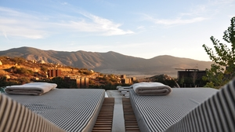


features
history
necessity
team
objective
about
Destination
Hotel Booking
My Trip
Utility
It helps decide the destination by providing real-time information about tourist spots, interesting trivia, local trends, weather, restaurants, monuments, and much more for travelers to explore unfamiliar cities.
Find great hotel deals and book your accommodation for your next trip in just a few minutes.
It allows users to store their travel history and future plans. They have the option to keep their trips private or share with others.
It gives a bunch of helpful utilities in one app including World Clock, checklists, compass, weather forecast.

Slide 11
@

Slide 12

FEATURES
It has become more than indispensable to focus comprehensively while integrating important features. Also, the trends in mobile app development keep renewing, offering an opportunity to add interesting and new features that draw users’ attention instantly along with being customer-friendly as well.

Slide 13
Work Process
Login Page
Home Page
START
01
03
02
04
Register Page
Destination

Slide 14
Work Process
Hotel Booking
Utility
END
05
07
06
08
My Trip
Logout

Slide 15

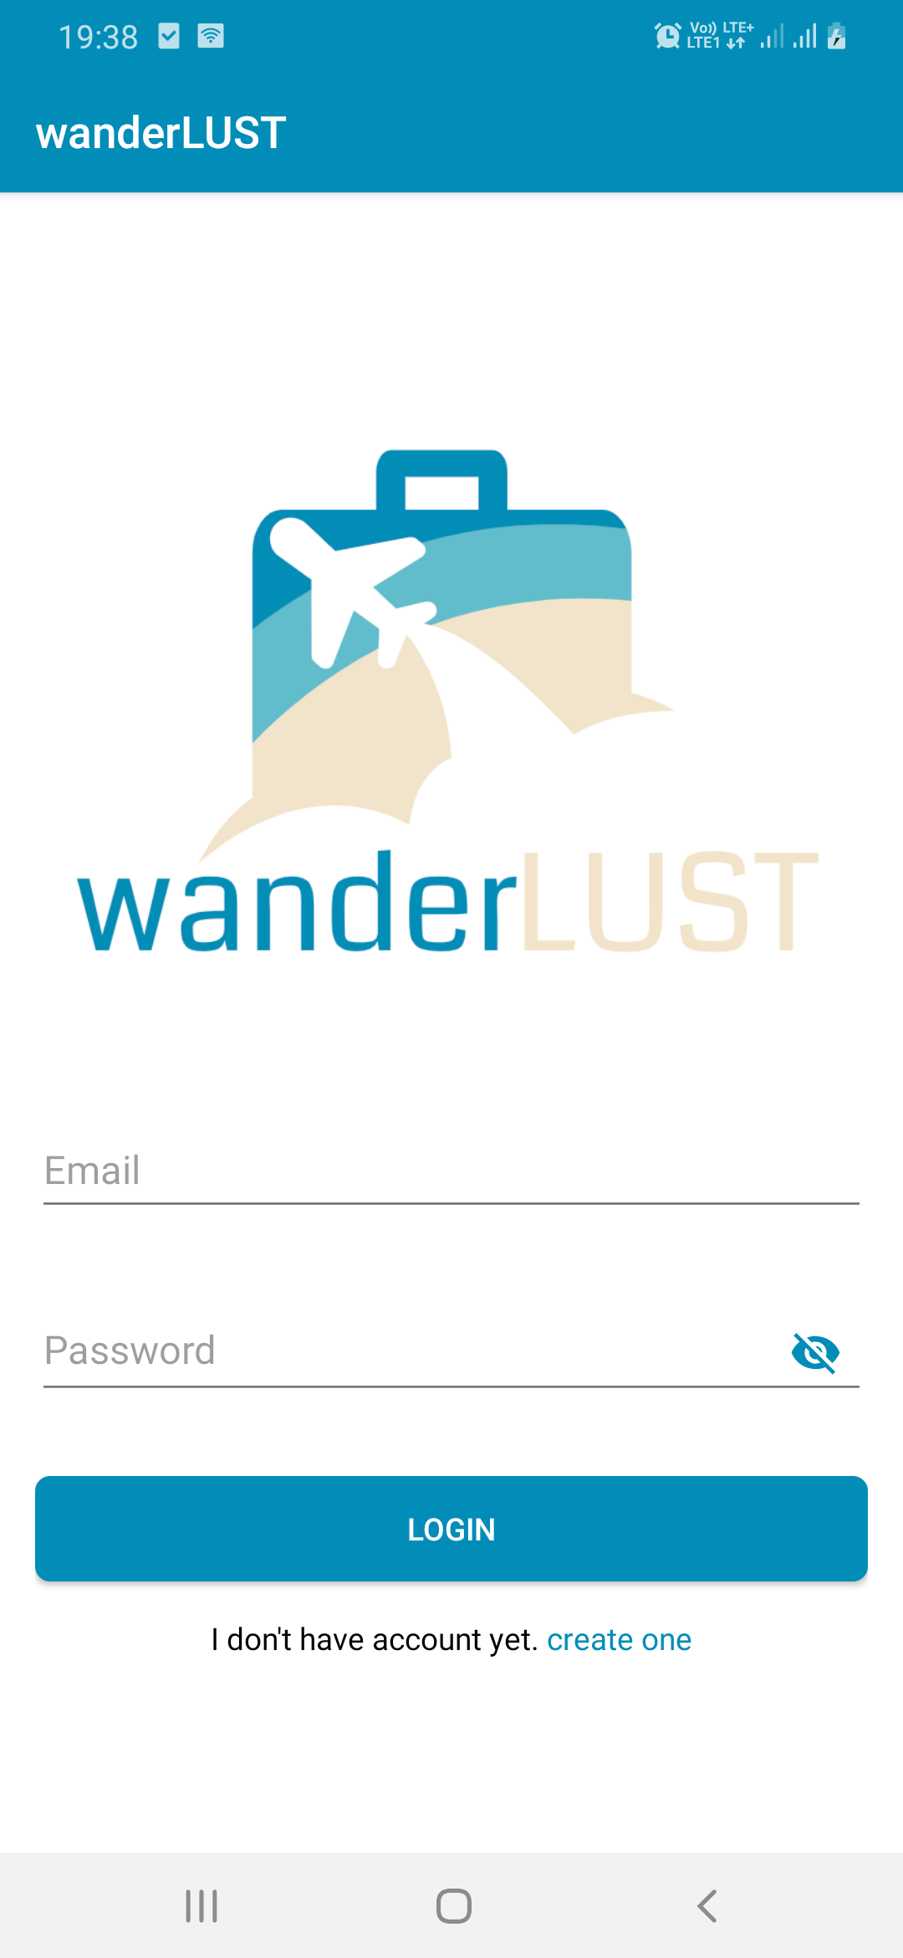
Login Page

Slide 16
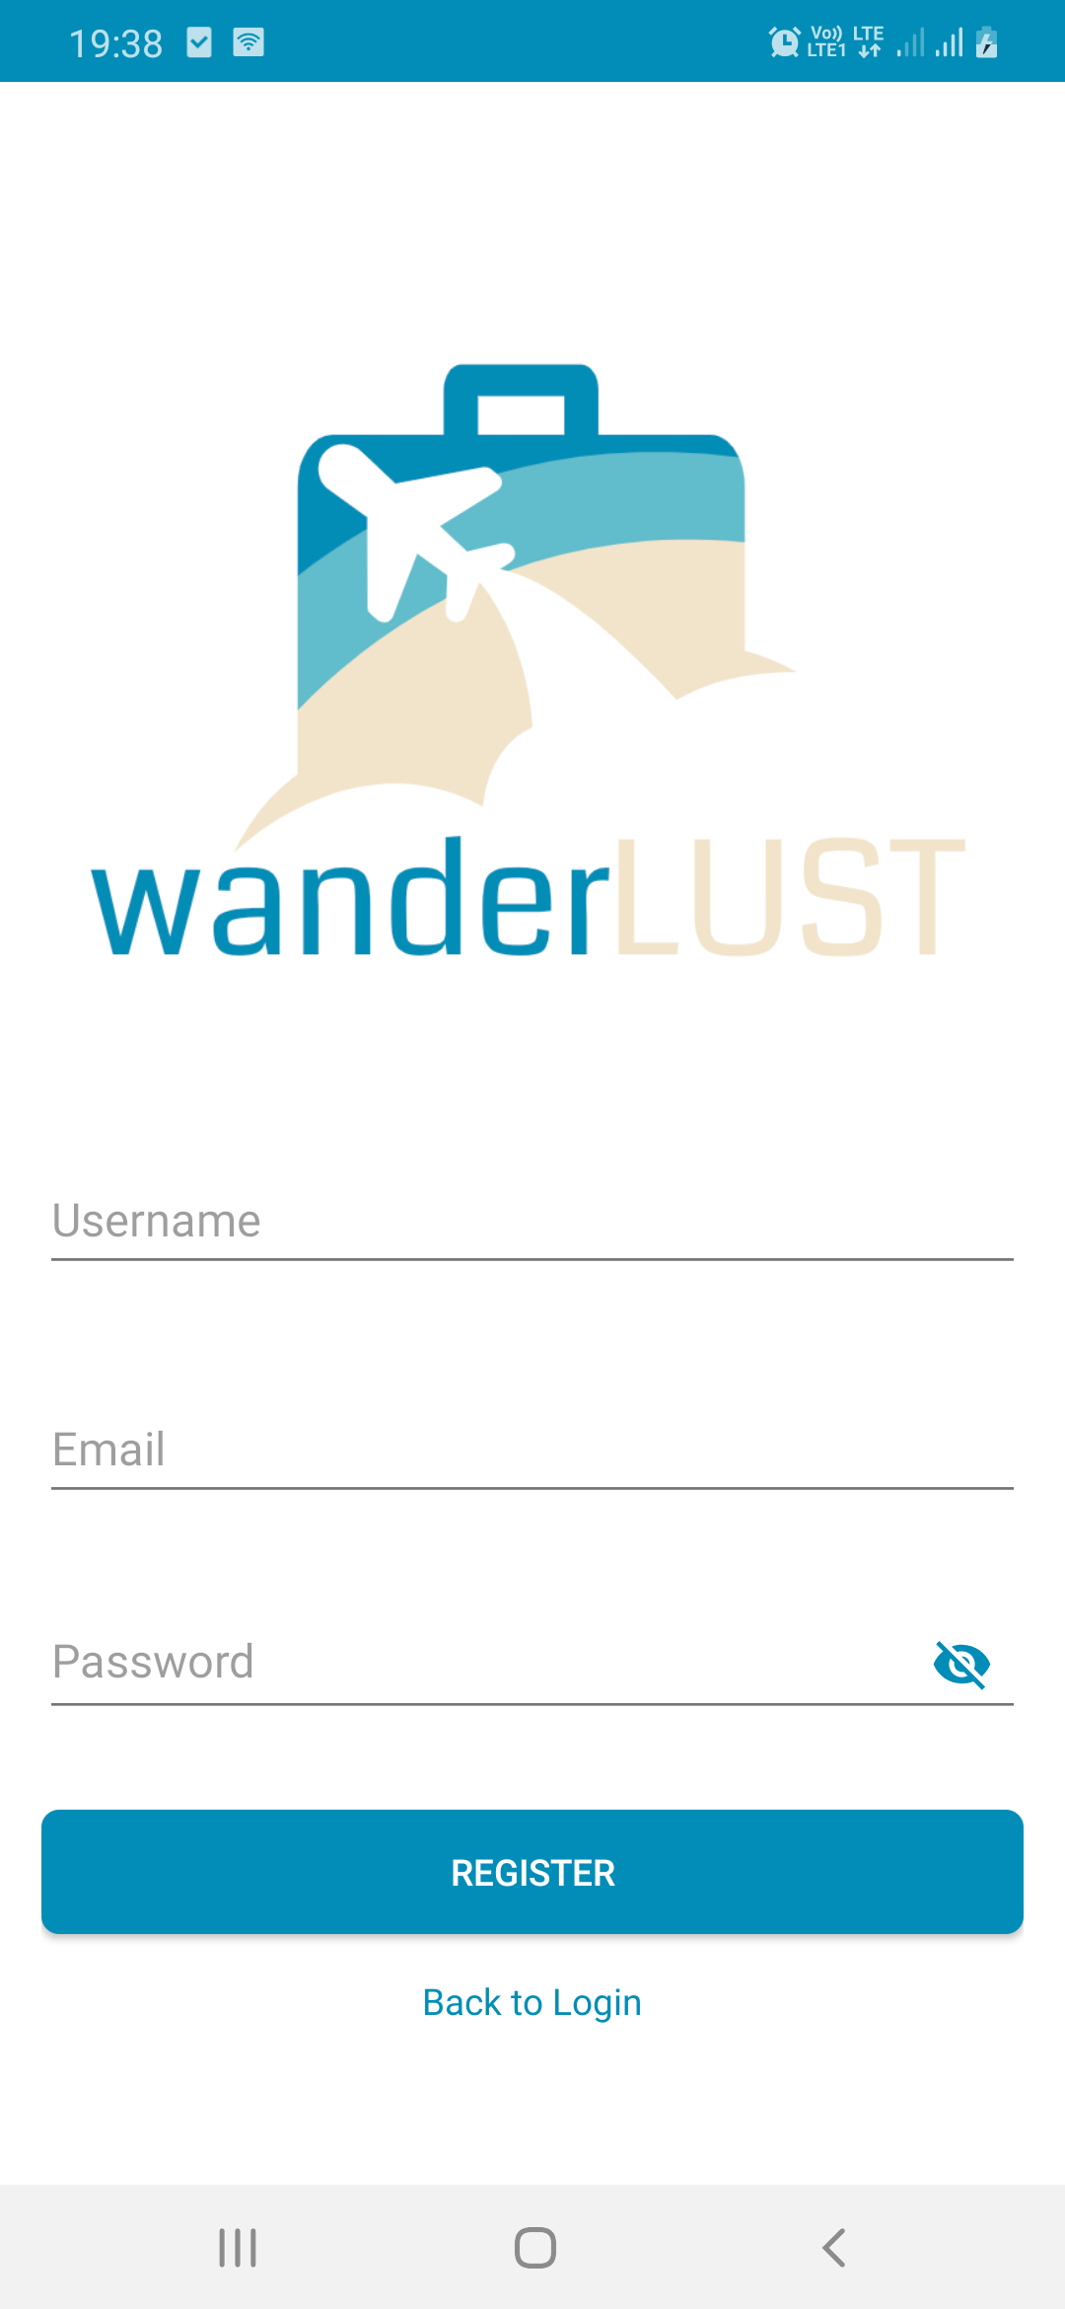
Register Page

Slide 17
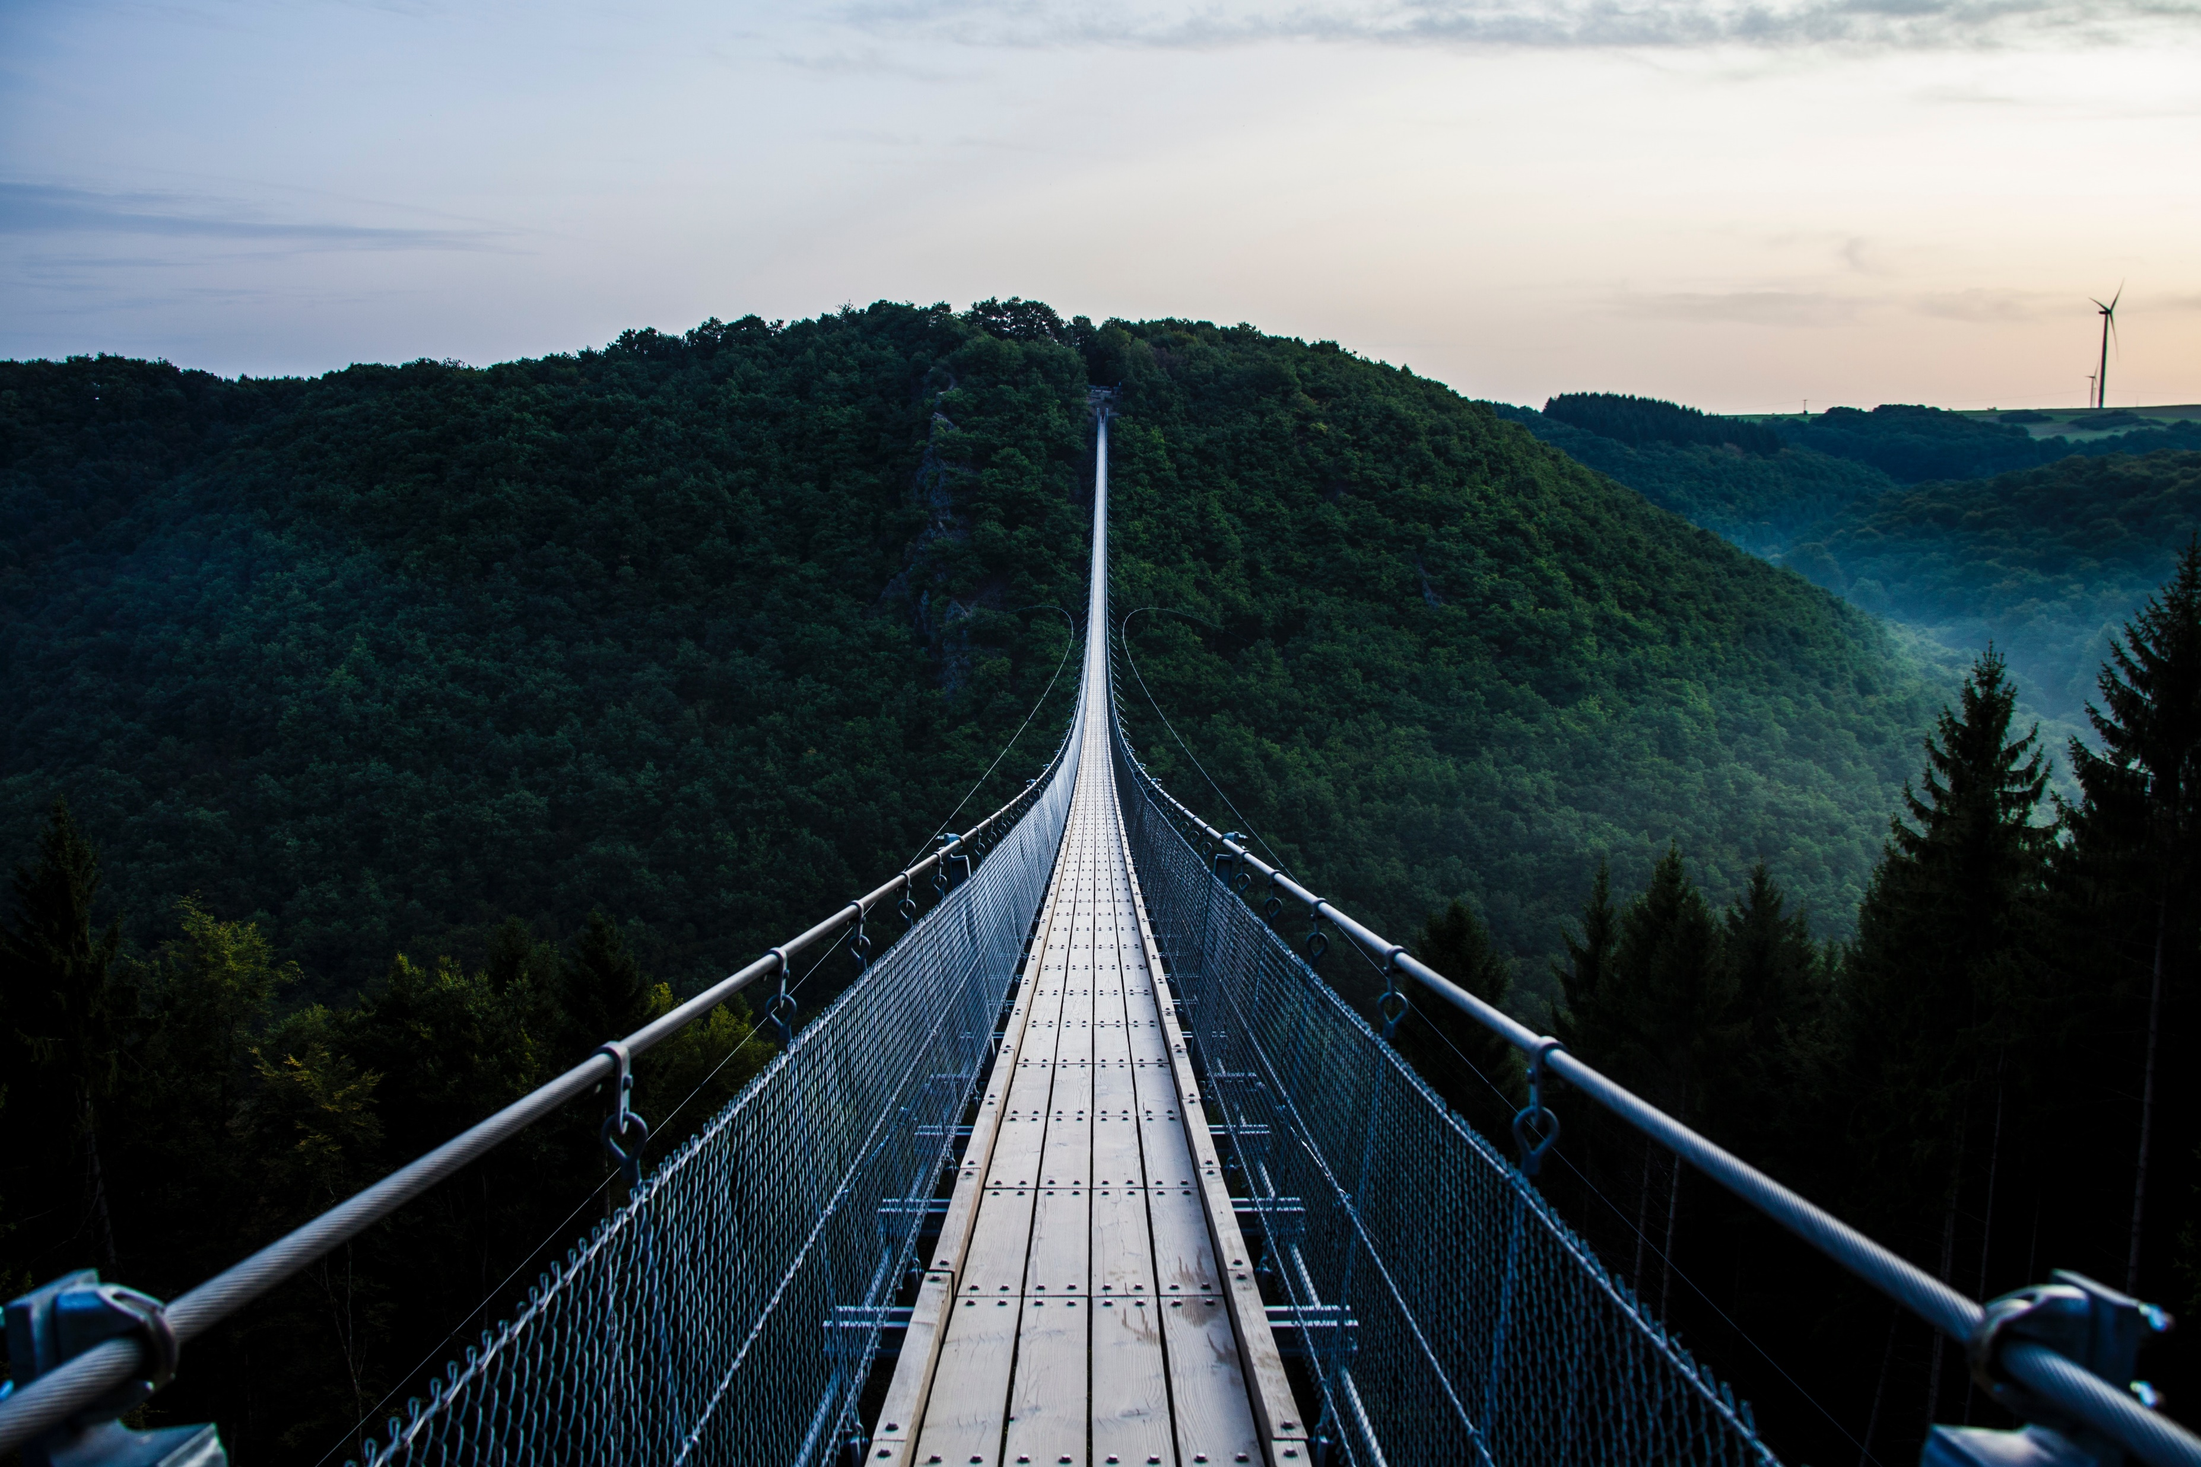
User. dB
STRUCTURE
In Table_1. User, there are primary key id, component id username, email & password.
id | username | email | password
1 | Yamuna K | yamuna.pixie@gmail.com | yamuna
2 | Test | test@gmail.com | test
3 | Tester | tester@gmail.com | tester

Slide 18
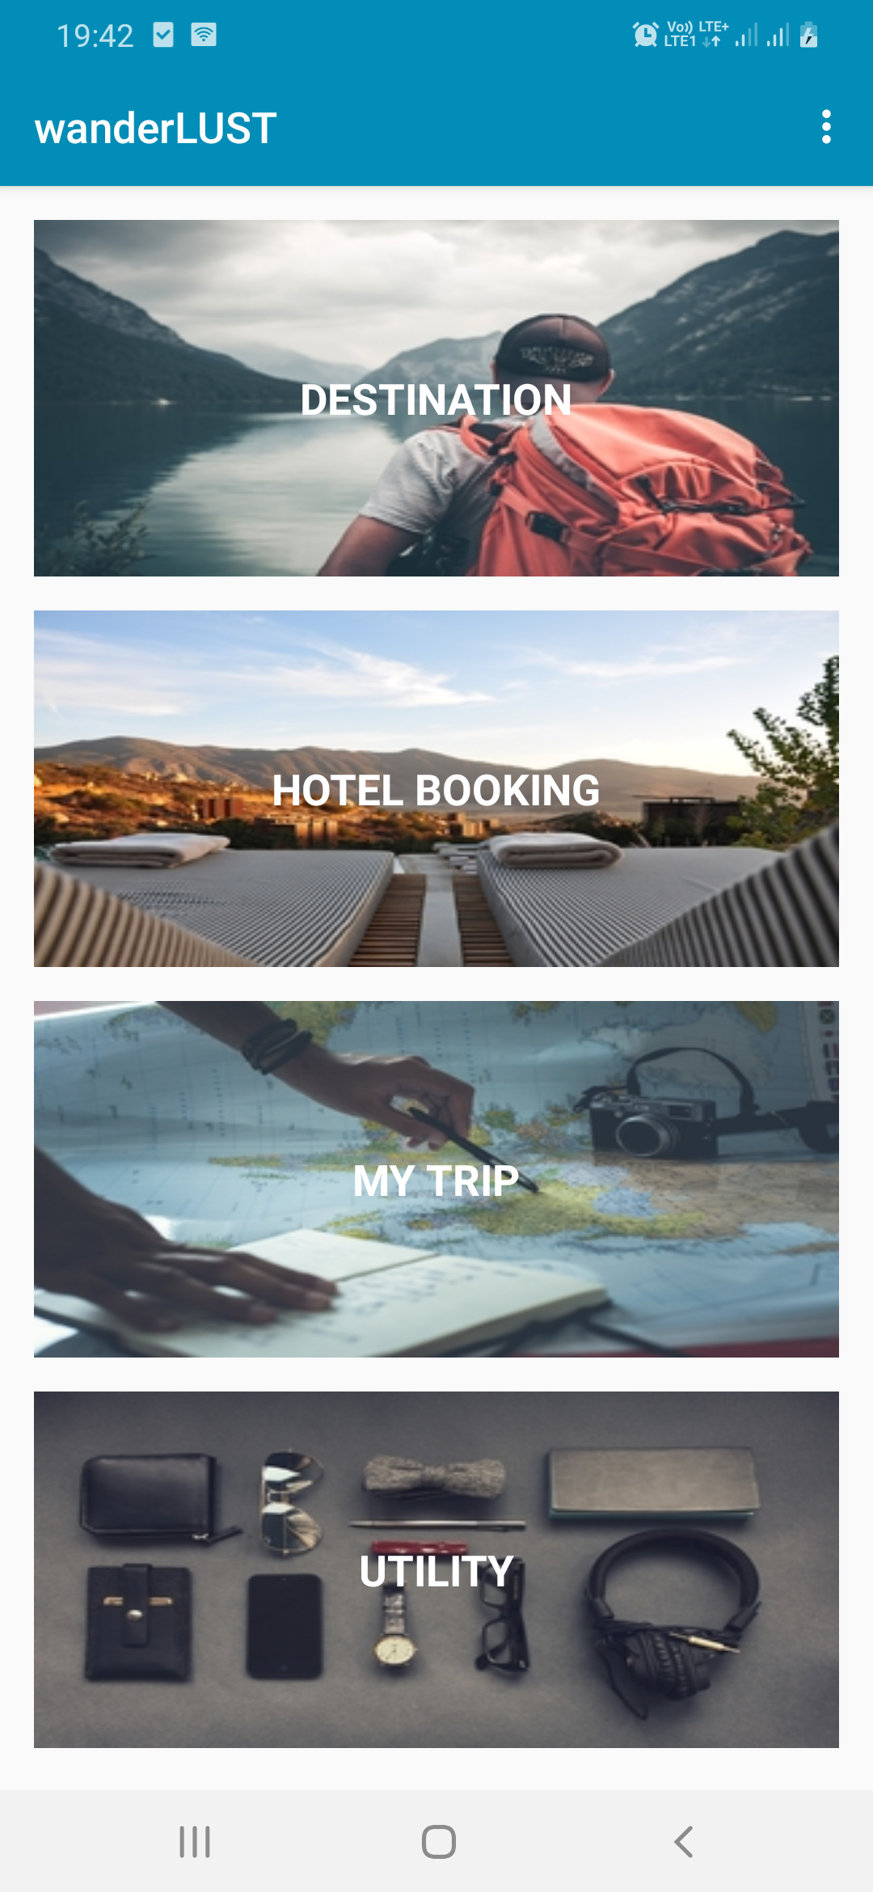
Home Page
The home page is the main page a user navigates to an app from the login page. It serves as the landing page to attract visitors. The home page is used to facilitate navigation to other pages on the app by clicking on various images and tabs present.
Destination
My Trip
It helps decide the destination by providing real-time information about tourist spots, local trends, weather, restaurants, monuments, and much more for travelers to explore unfamiliar cities.
It allows users to store their travel history and future plans. They have the option to keep their trips private or share with others.
1
3
Hotel Booking
Utility
Find great hotel deals and book your accommodation for your next trip in just a few minutes.
It gives a bunch of helpful utilities in one app including World Clock, checklists, compass, weather forecast.
2
4

Slide 19
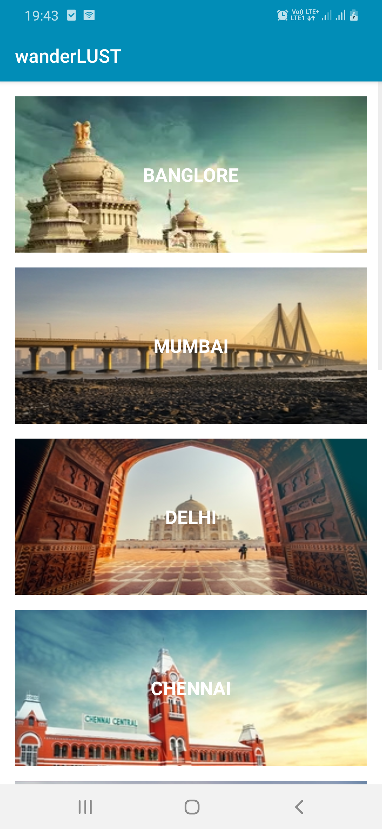
Destination
It helps decide the destination by providing real-time information about tourist spots, interesting trivia, local trends, weather, restaurants, monuments, and much more for travelers to explore unfamiliar cities.

Slide 20
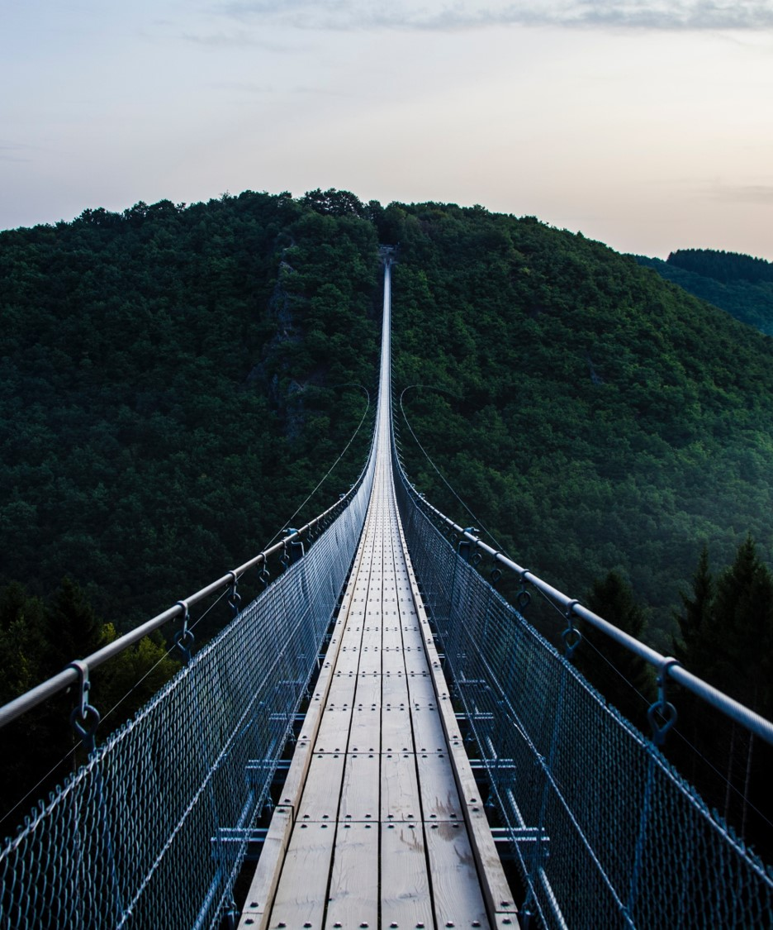
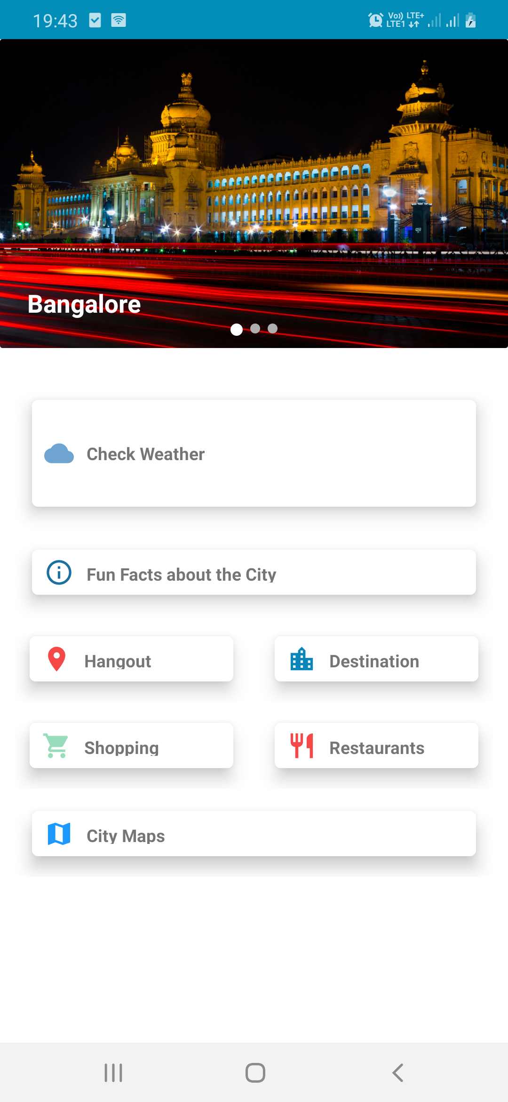
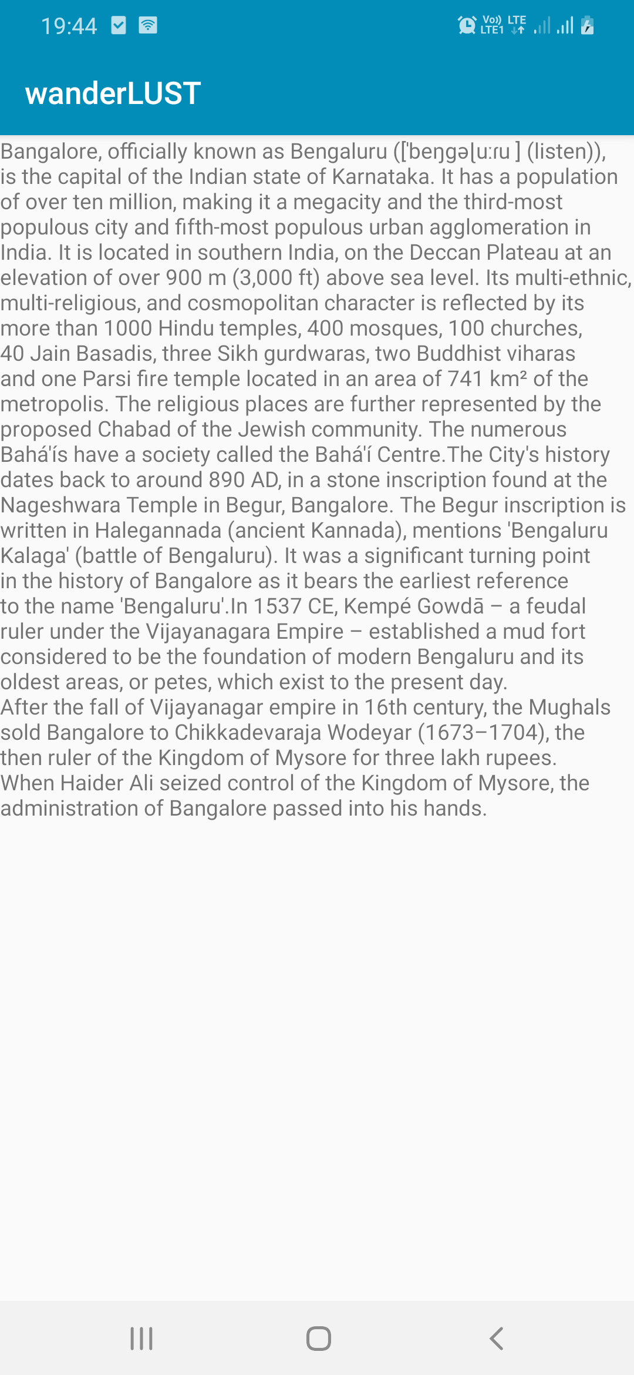
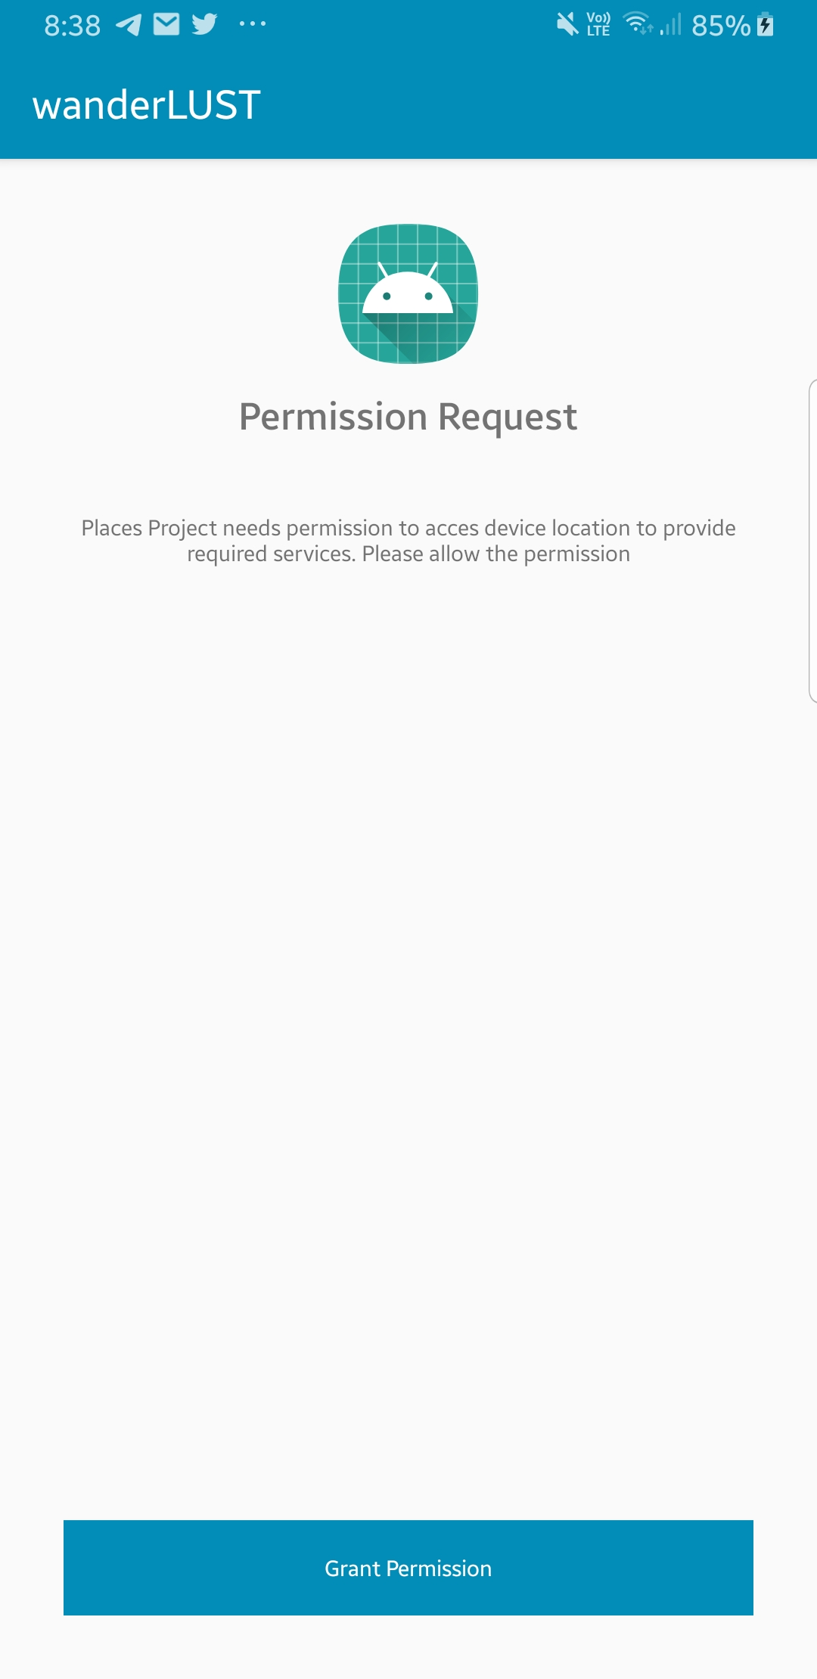

Slide 21
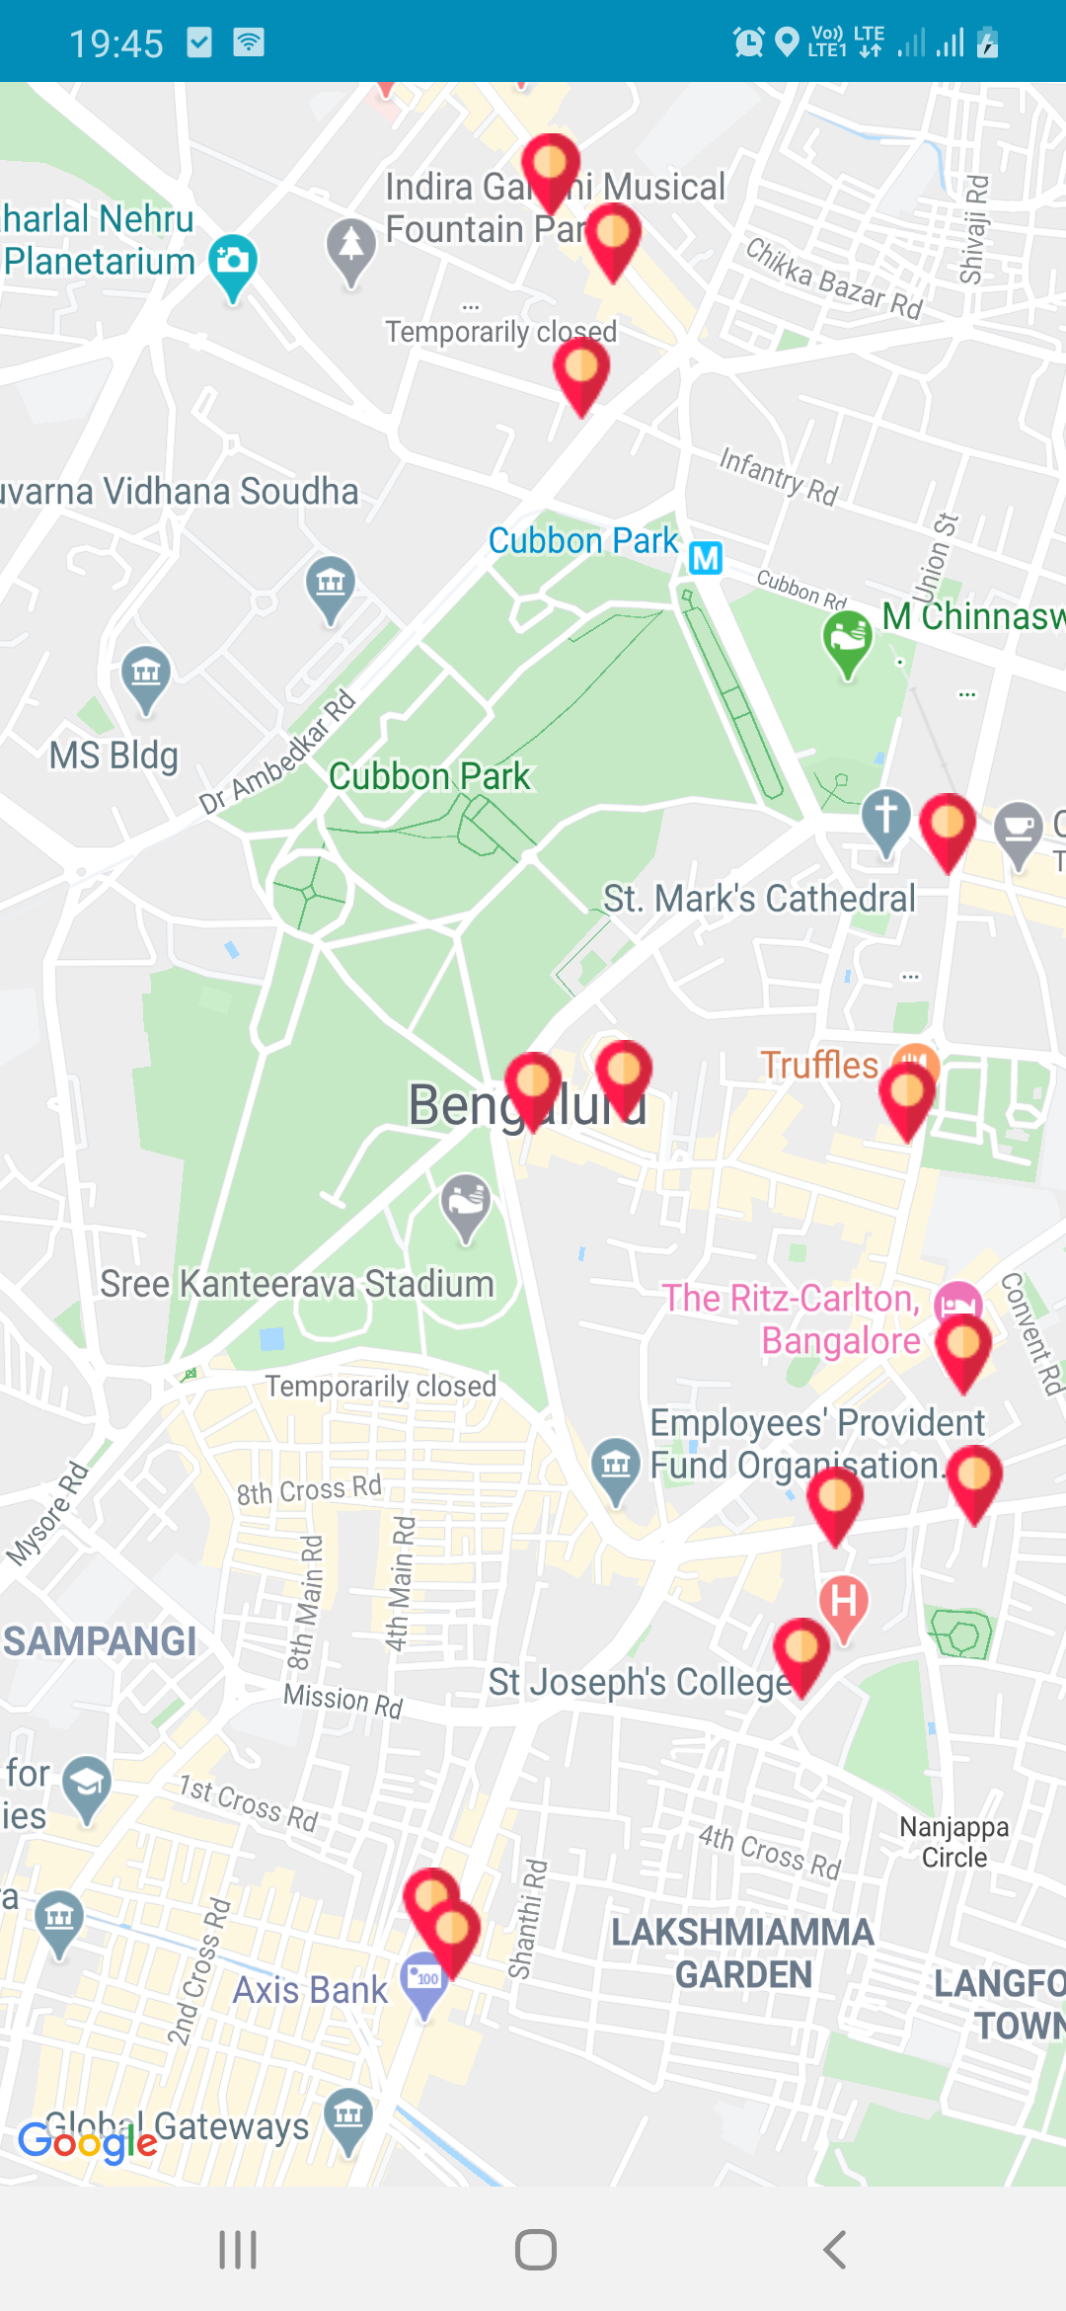
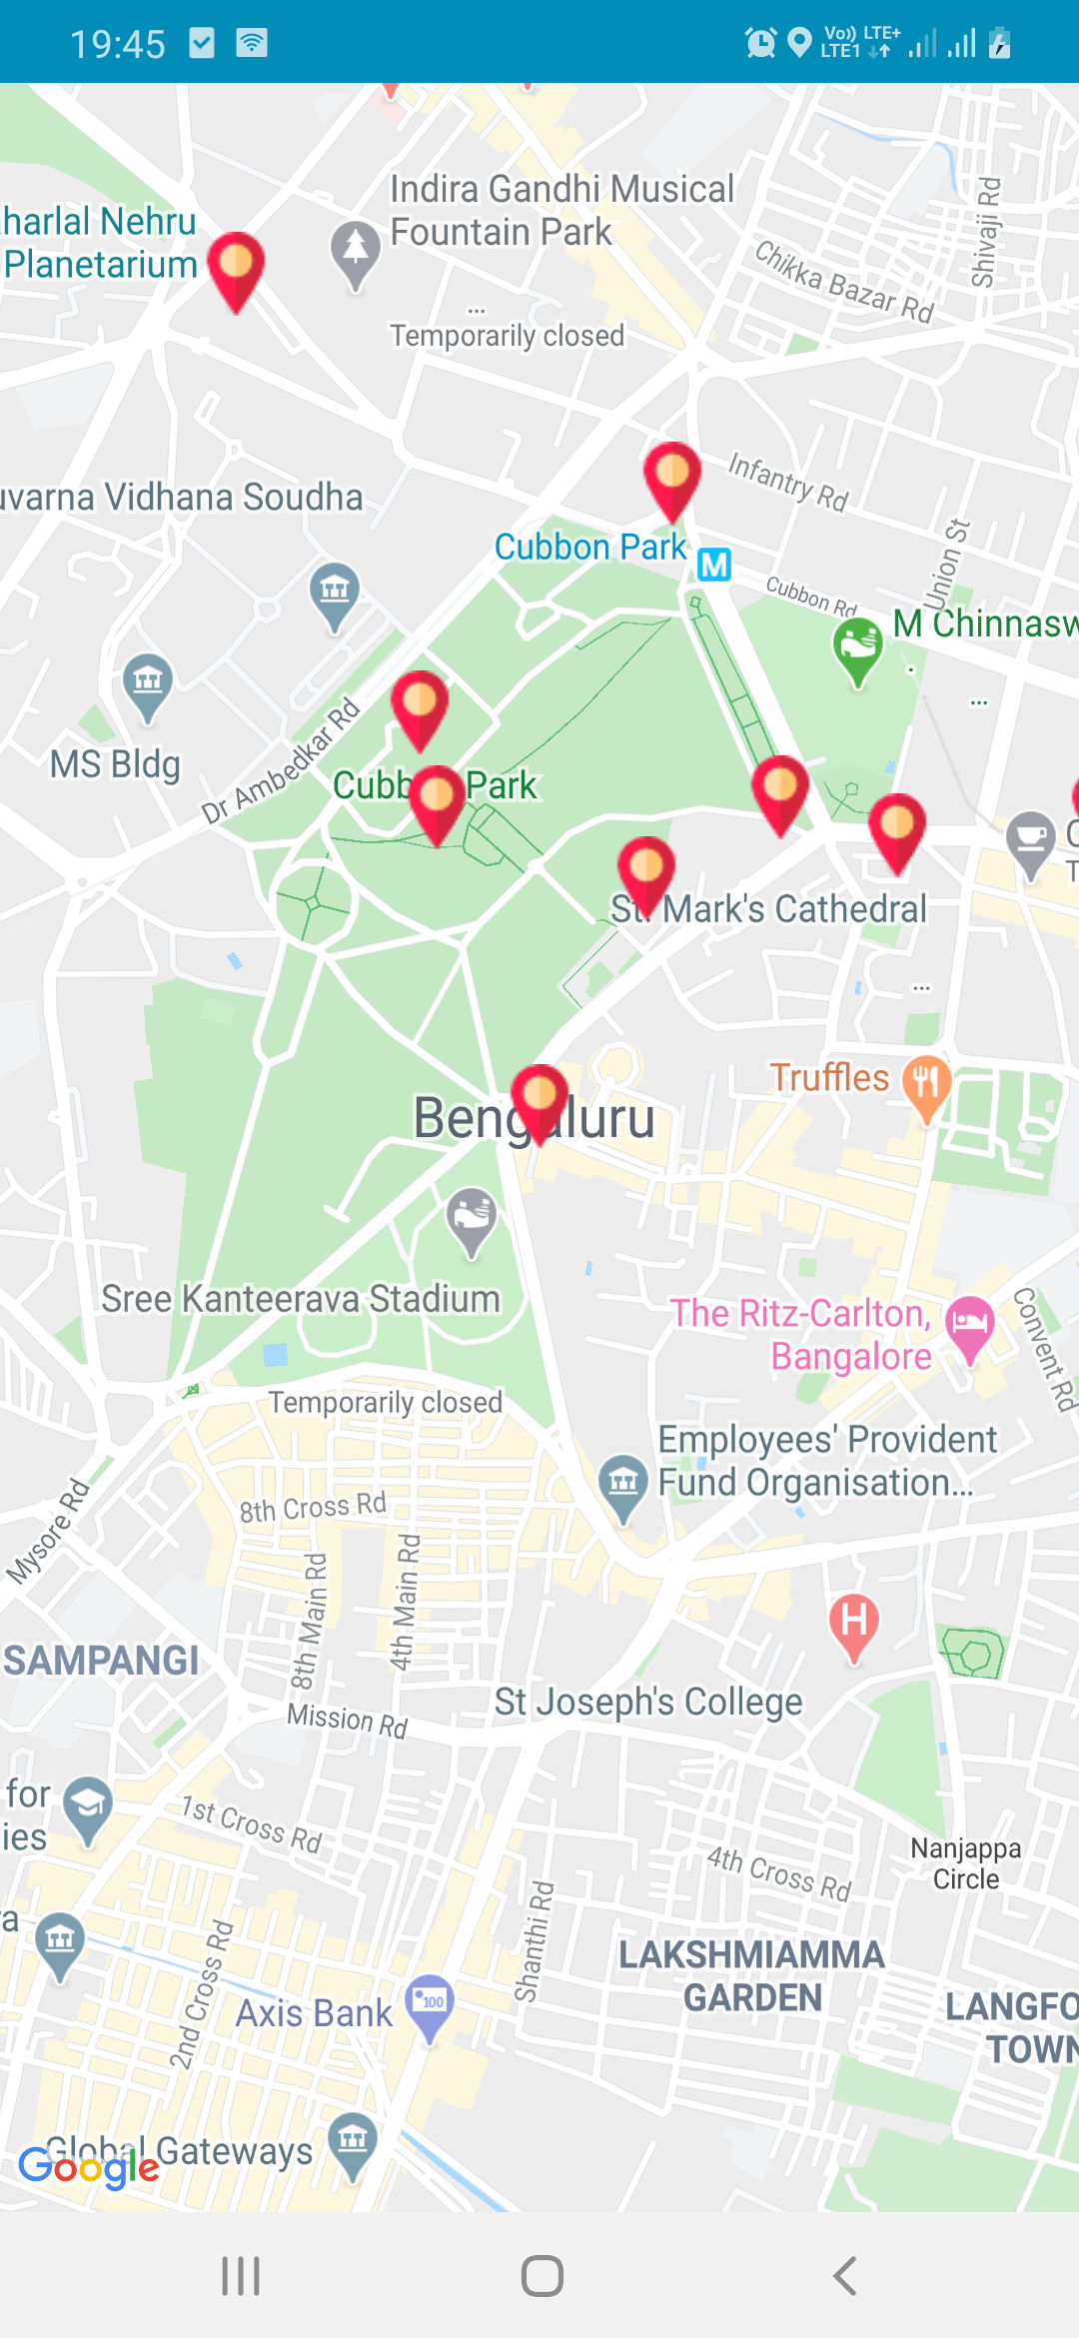
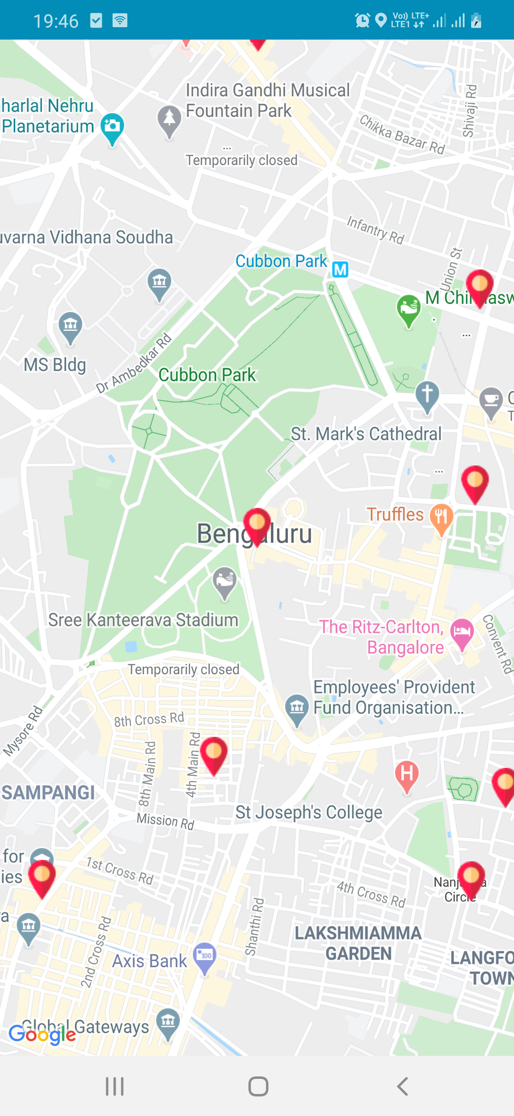

Slide 22
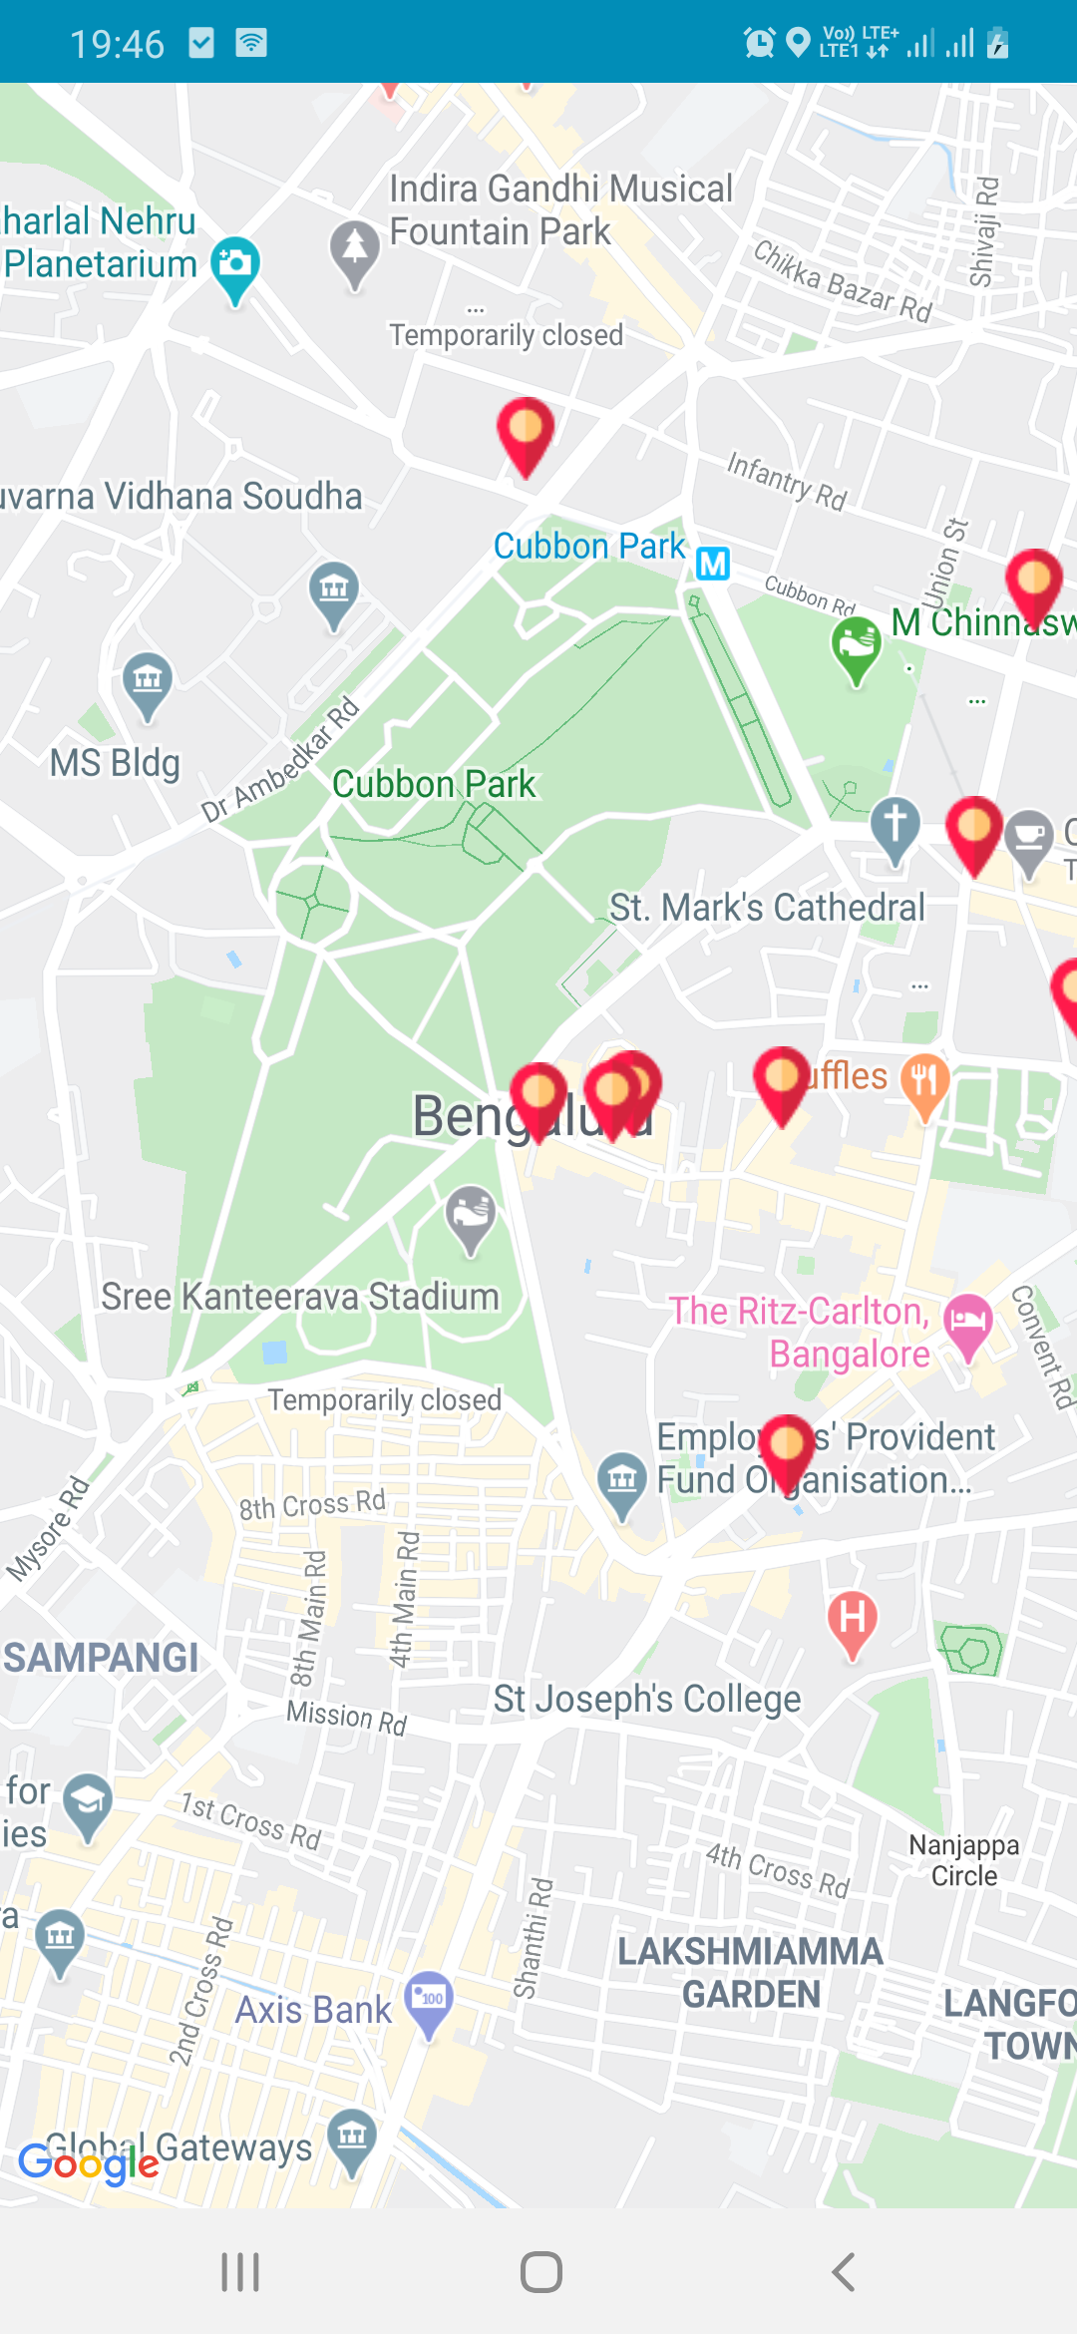
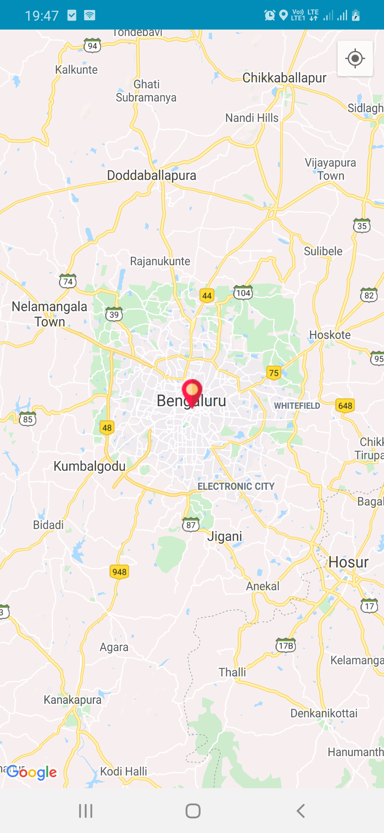

Slide 23
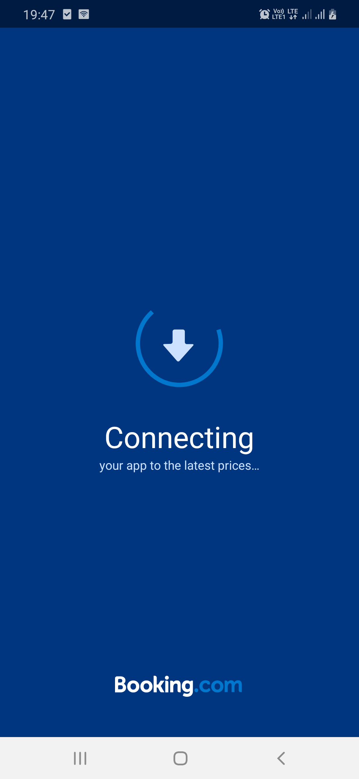
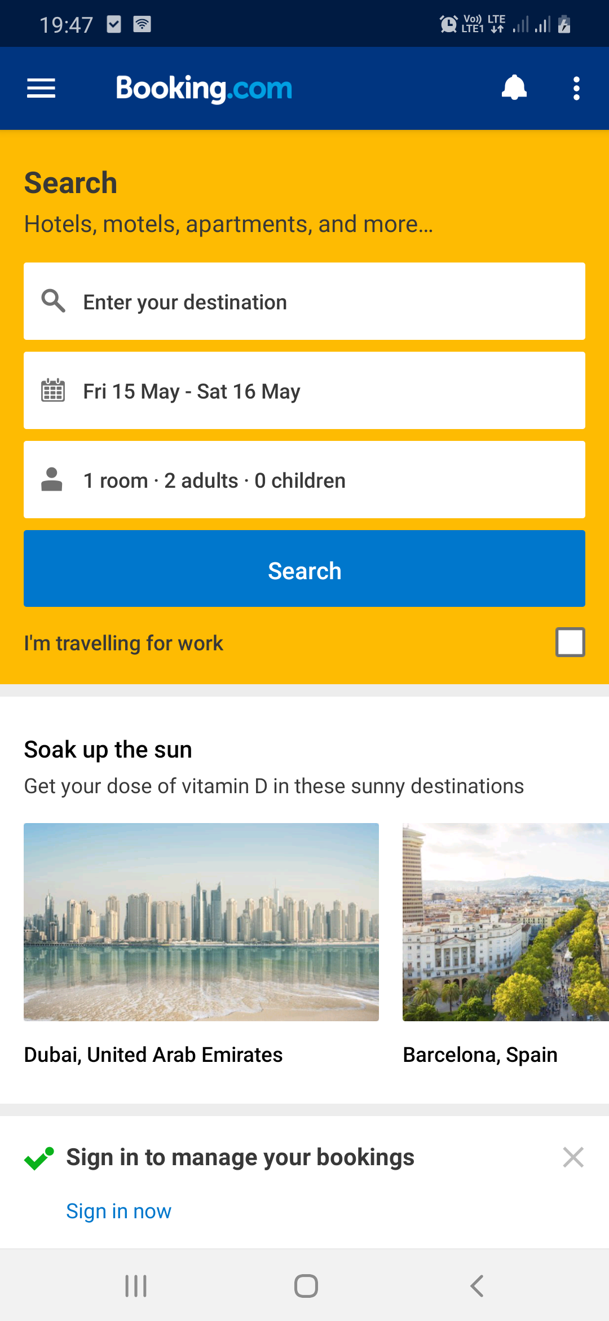
HOTEL BOOKING
Booking.com’s mission is to make it easier for everyone to experience the world. Booking.com seamlessly connects millions of travelers to memorable experiences, a variety of transportation options, and incredible places to stay – from homes to hotels, and much more.
Booking.com is available in 43 languages and offers more than 28 million reported accommodation listings, including over 6.2 million homes, apartments, and other unique places to stay. Wherever you want to go and whatever you want to do, Booking.com makes it easy and supports you with 24/7 customer support.

Slide 24
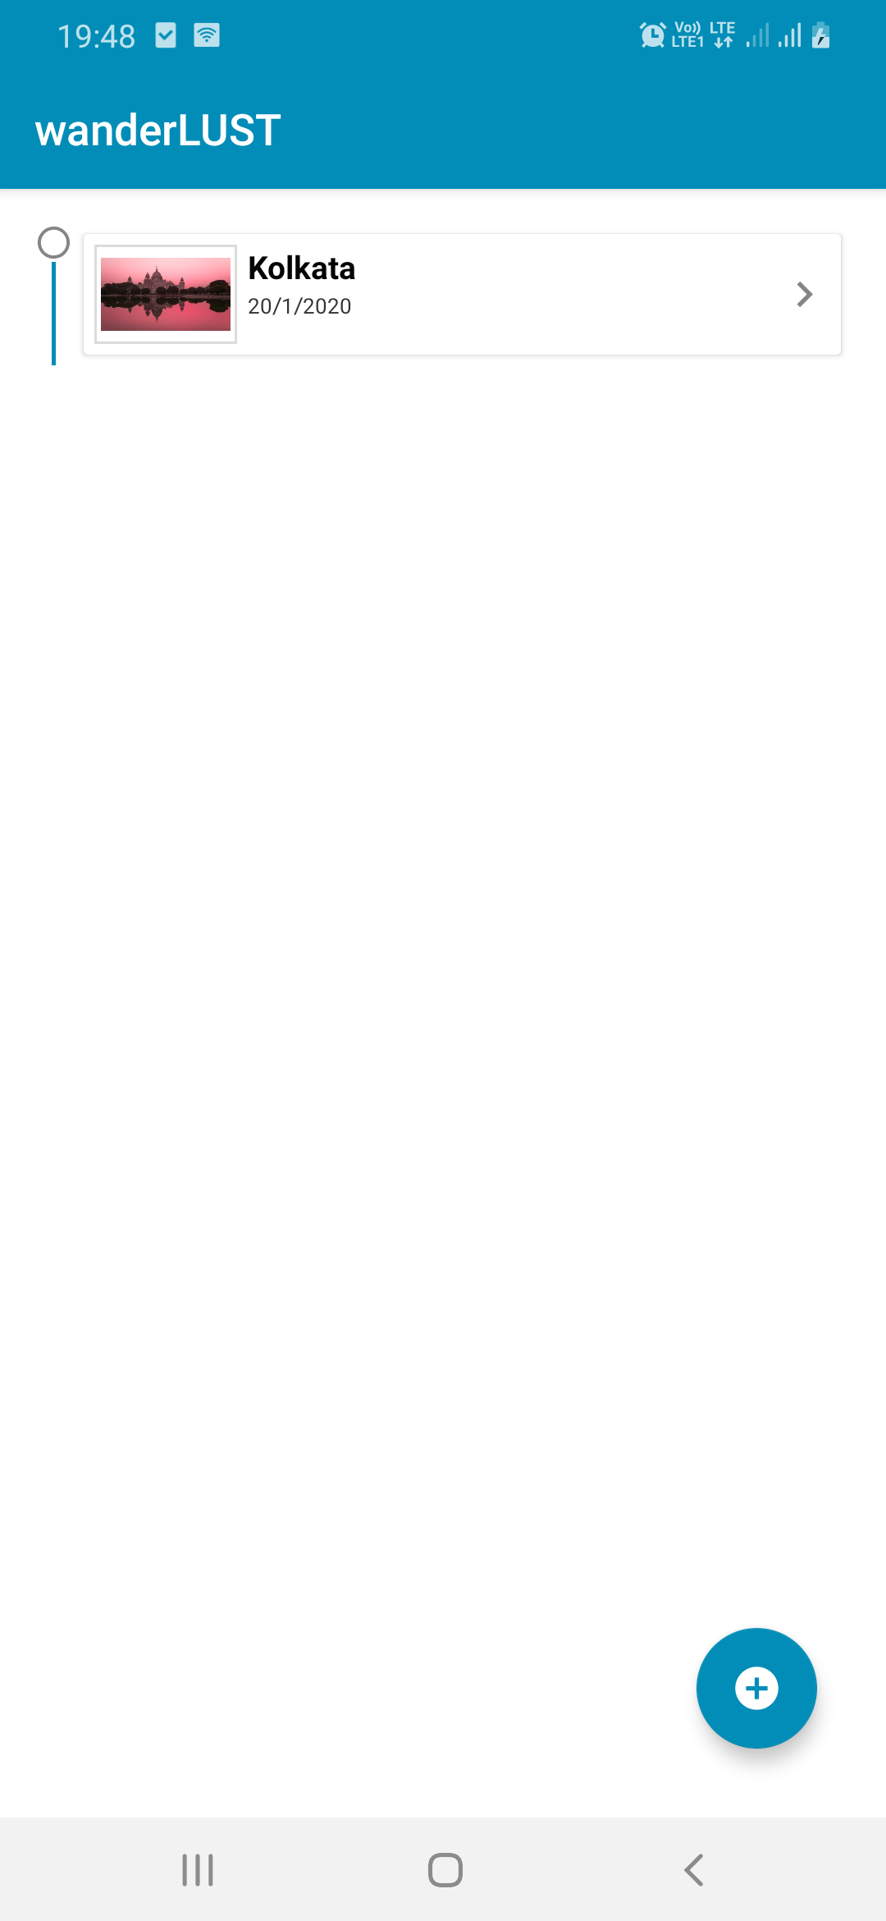
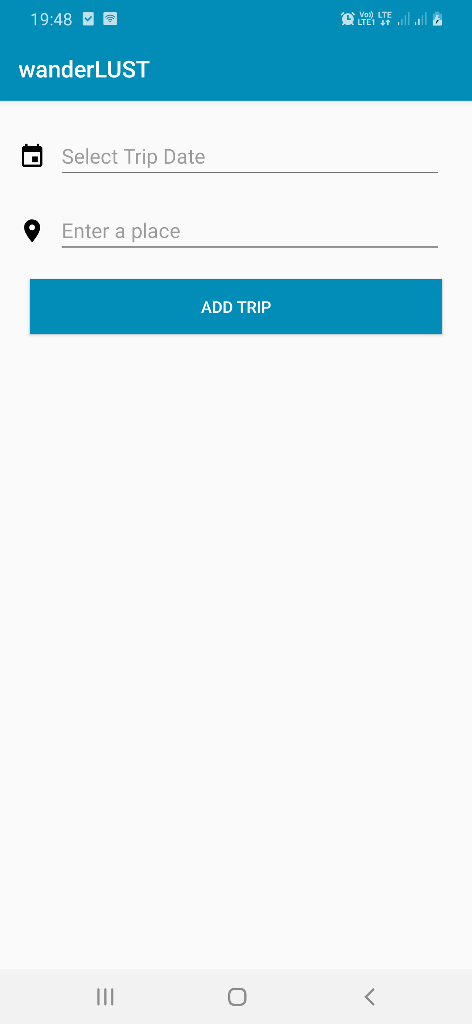
My Trip
It allows users to store their travel history and future plans. They have the option to keep their trips private or share with others.

Slide 25
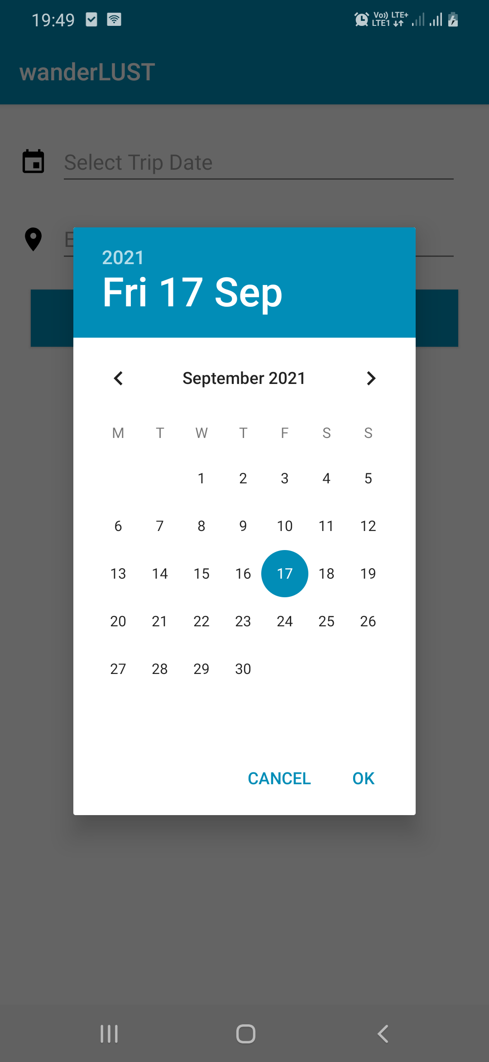
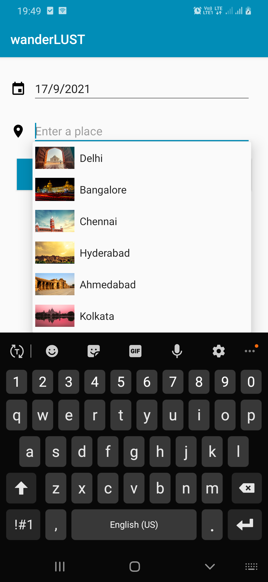
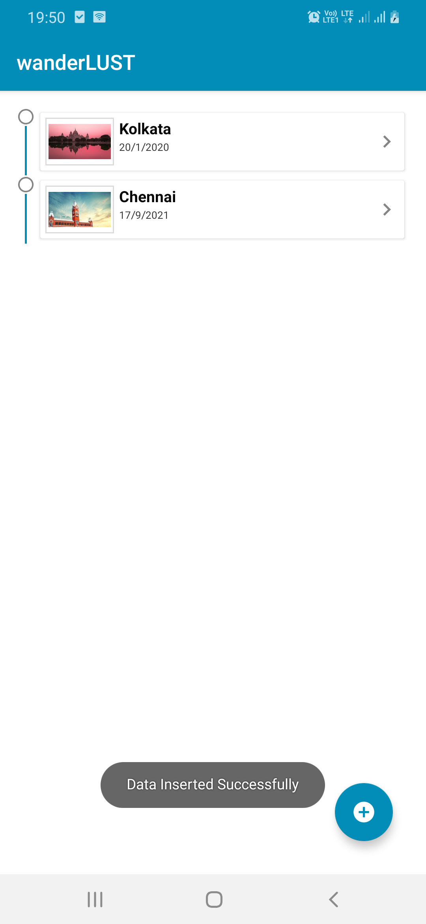

Slide 26
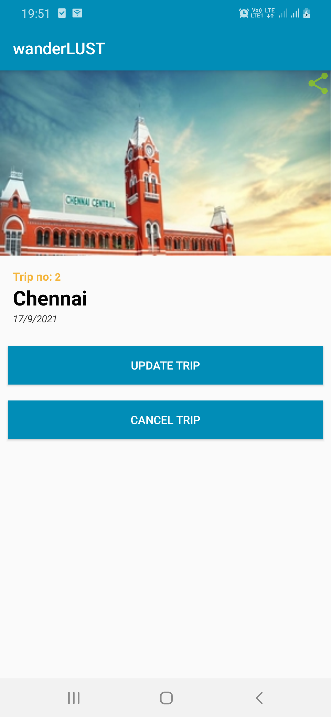
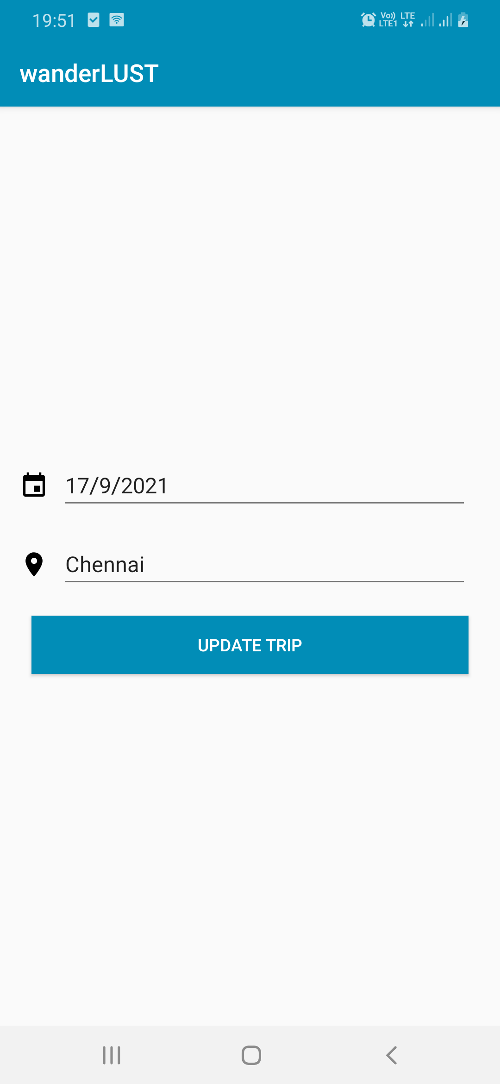
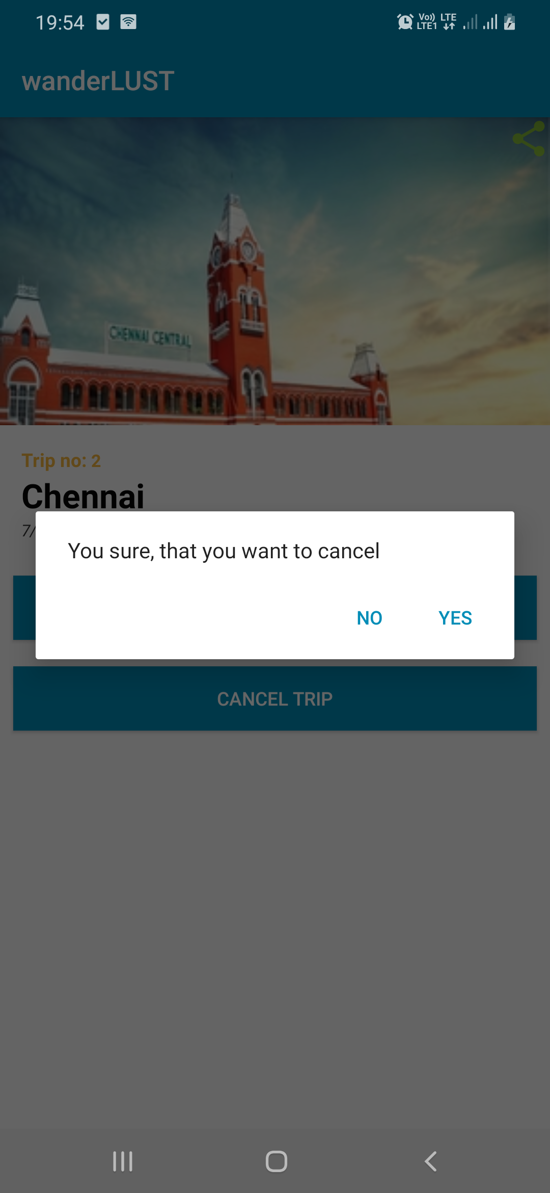

Slide 27
Trip. dB
STRUCTURE
In Table_2. Trips, there are primary key id, component id placename & date.
id | placename | date
1 | Kolkata | 20-01-2020
2 | Chennai | 17-09-2021

Slide 28
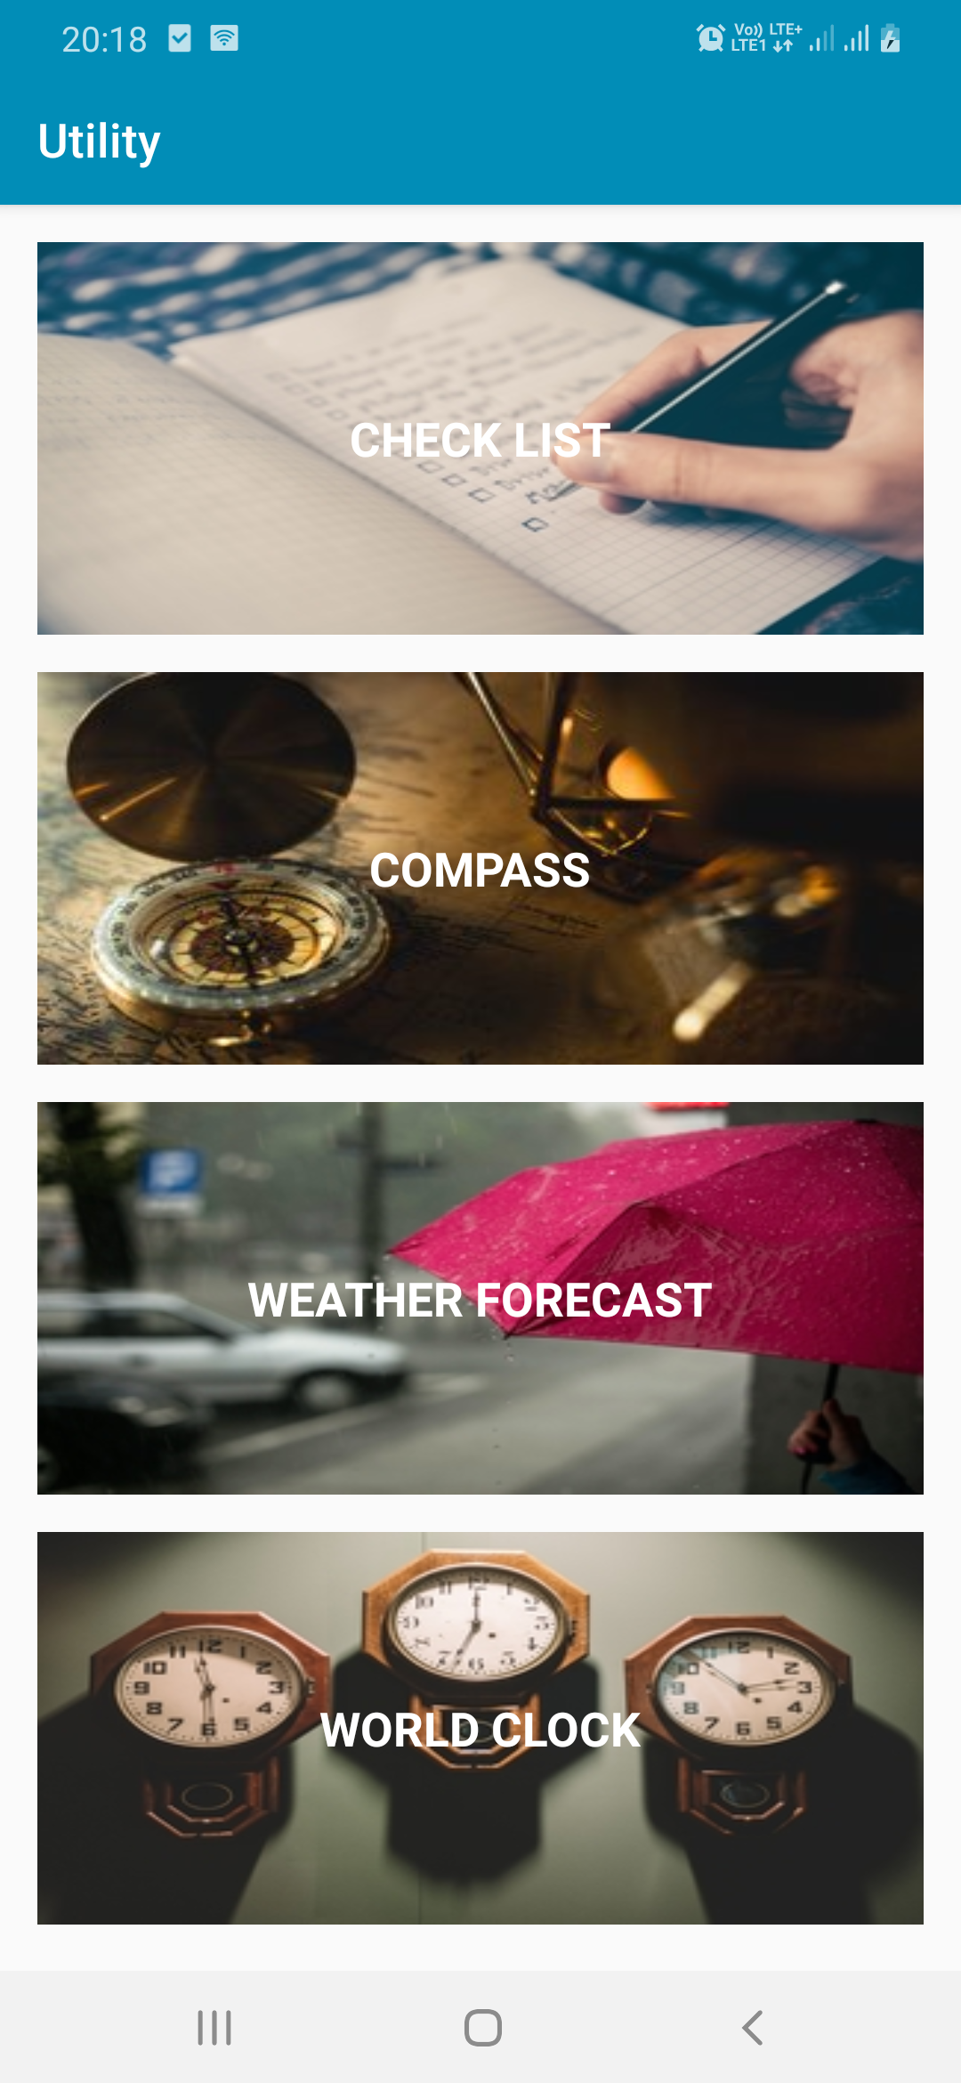



Utility
It gives a bunch of helpful utilities in one app including World Clock, Checklists, Compass, Weather forecast.
FEATURES
_{CHECKLIST}
_{COMPASS}
_{WEATHER}
_{FORECAST}
_{WORLD CLOCK}

Slide 29
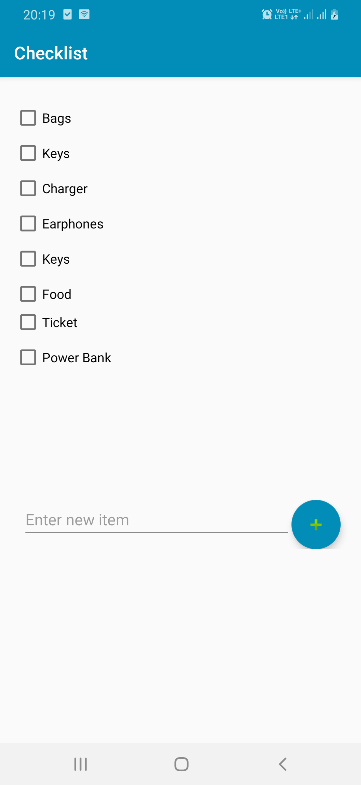
CHECKLIST
Even in our post-digital world, there are some physical items you can’t do without – especially on a business trip. Forget your passport and you won’t be getting on your flight. Forget your phone or laptop and you’ll struggle to communicate with your colleagues and clients. Forget important business documents and you could be risking anything from your professional reputation to a client relationship. These are all easy mistakes to make, but you can see how much they would cost your business to put right – and cause you stress in the process.
This handy guide explains how to pack for a trip, say business trip – giving you more time to focus on acing your meeting or that big conference you’re presenting at.

Slide 30
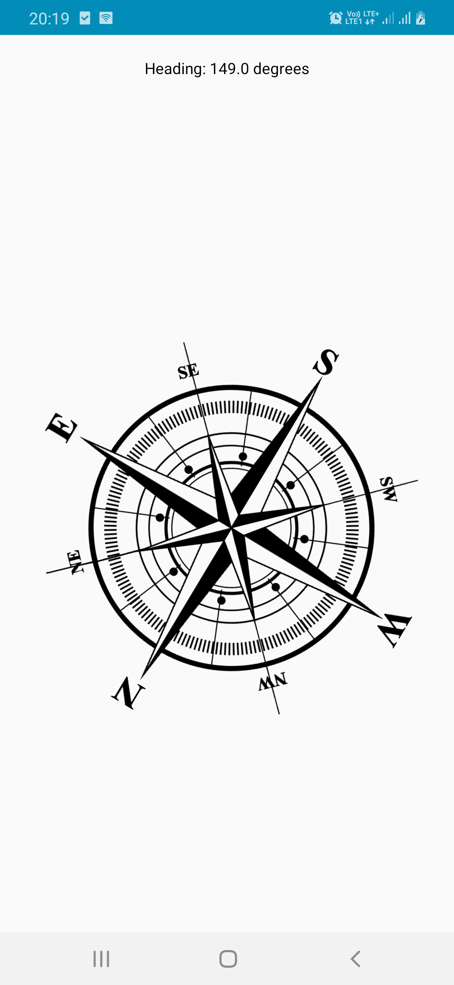
COMPASS
The compass is used for navigation, location and direction. People use it to find their way, whether it is on a hiking trail or on a trip to a new location. ... Through a slight left or right turn, a compass will accurately point to the North Pole and identify the angles of the other cardinal directions.

Slide 31
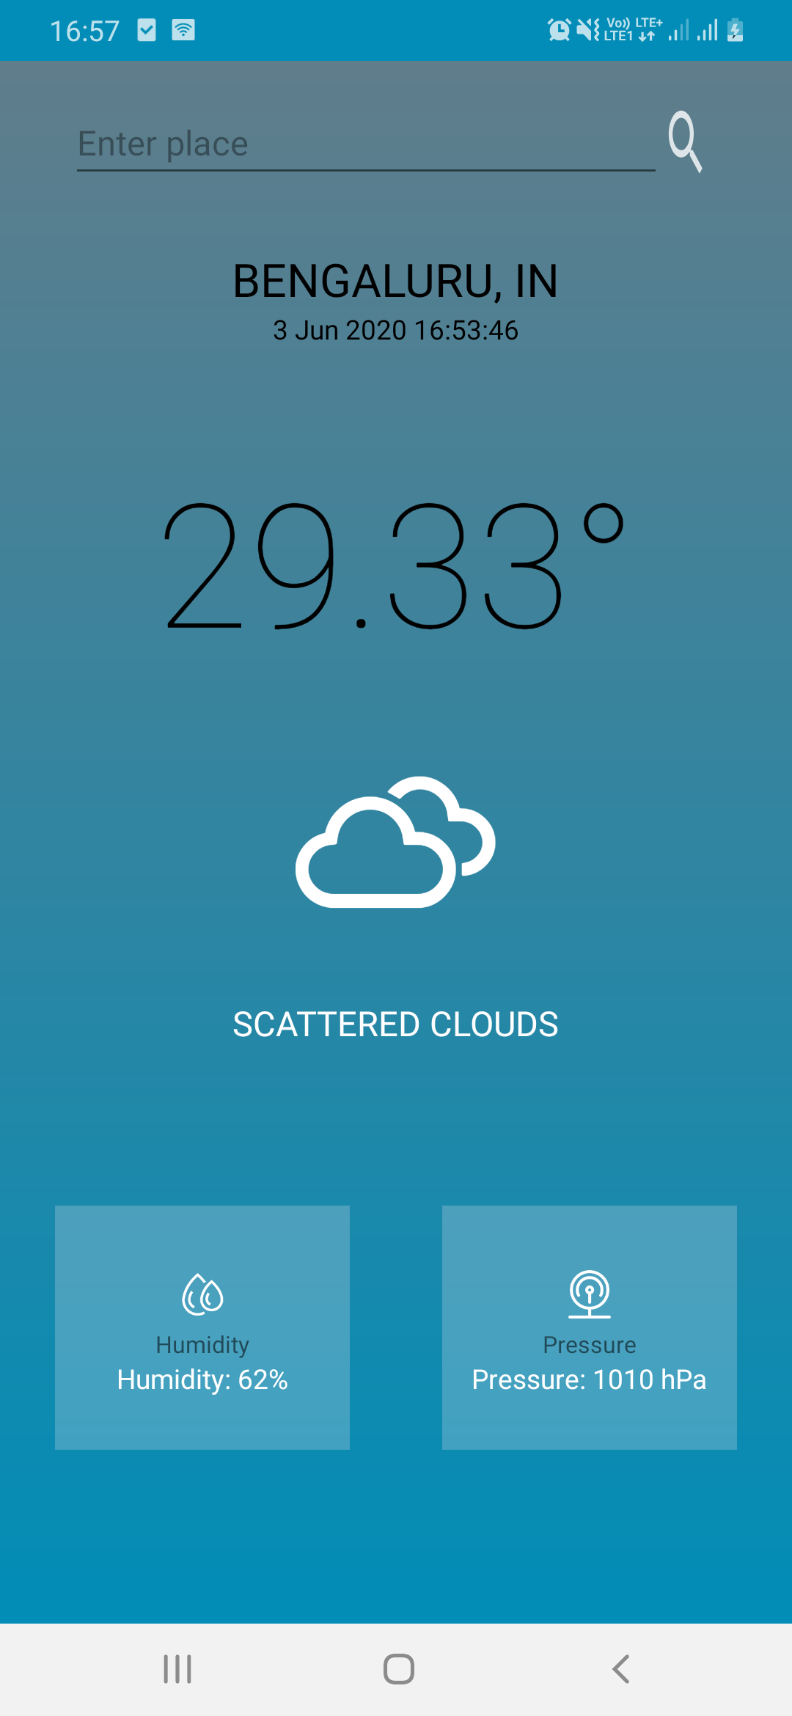

WEATHER FORECAST
Climate and weather are important factors in tourists’ decision making and also influence the successful operation of tourism
businesses. More specifically, climate is defined as the prevailing condition observed as a long term average in a location. In
contrast, weather is the manifestation of climate at a specific point in time and place. So, while tourists might expect certain climatic conditions when they travel to a place, they will experience the actual weather, which might deviate quite substantially from the
average conditions. Hence, in the first place tourists and tourism businesses are likely to be affected by weather conditions, although in the long term these will follow systematic changes as projected under different climate change scenarios. For example, surface
and sea temperatures are generally forecast to increase, rain patterns will change with some areas becoming wetter and others
driers, and the occurrence of extreme events is likely to increase. For this reason, tourist destinations will benefit from understanding potential climatic changes in their area and how they might impact on their operations.

Slide 32
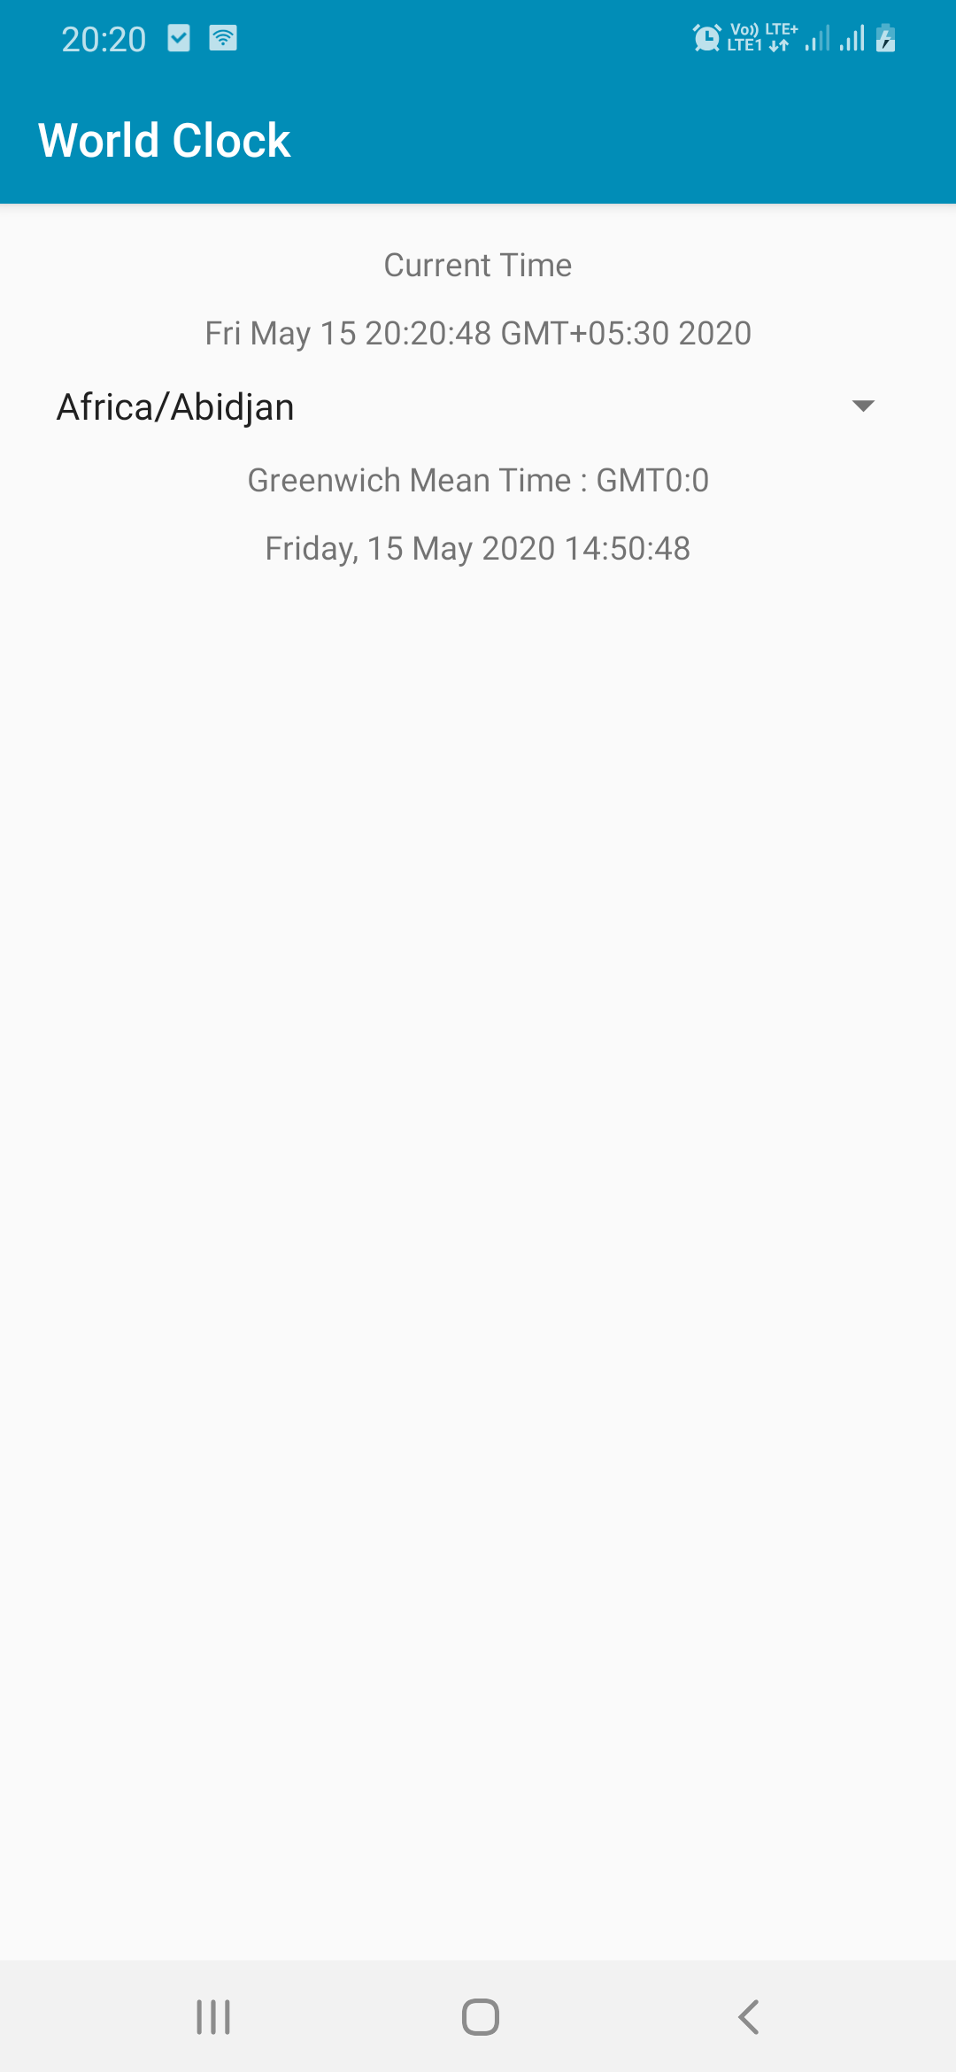
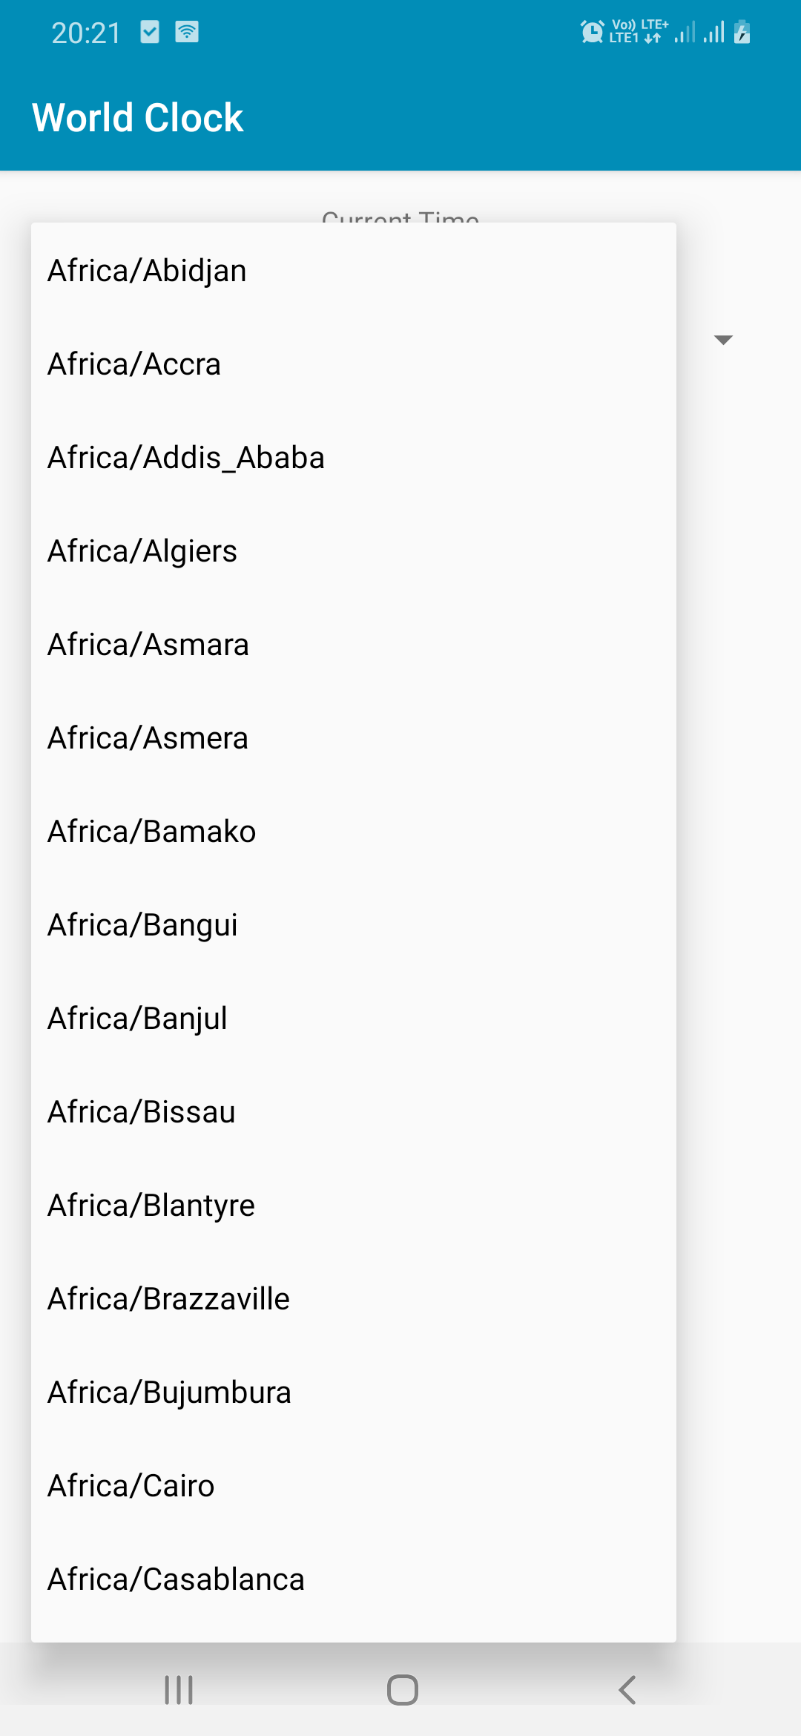
WORLD CLOCK

Slide 33
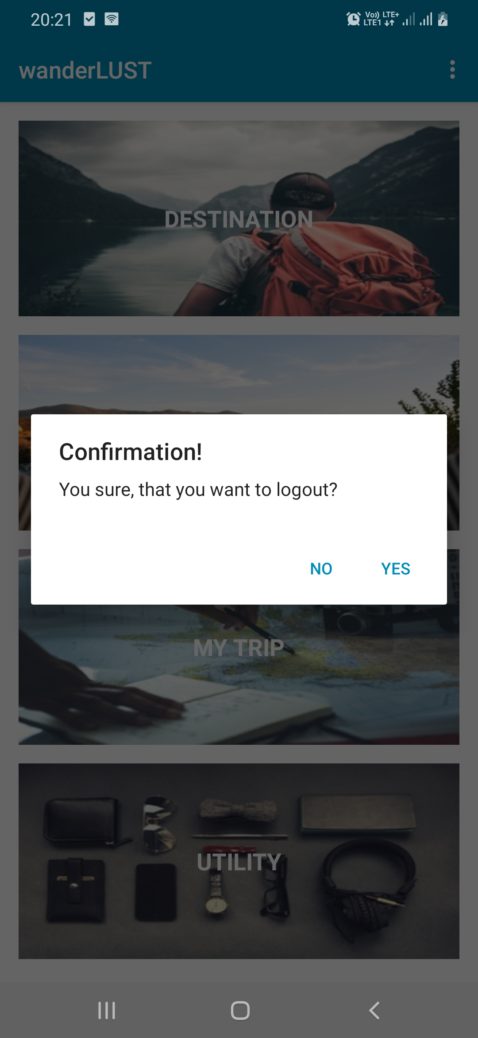
Logout

Slide 34
CONCLUSION
ENDLESS JOURNEY

Slide 35
DEMO

Slide 36
THANK YOU!

